Slide 1
Lab 0: Introduction to Jupyter
Big Ideas in Computing and Information
Griffin Hurt
Griffin Hurt
Undergraduate Teaching Fellow
griffhurt@pitt.edu
https://griffinhurt.com
Spring 2024, Term 2244
Friday 11 AM Lab
Jan 19th, 2024
Slides adapted from
Shinwoo Kim, Martha Dixon, and Vinicius Petrucci
Department of Computer Science
School of Computing & Information
University of Pittsburgh
Introduction
Using JupyterLab
Downloading Lab Materials
Intro to Jupyter Notebooks
Uploading to Canvas

Slide 2
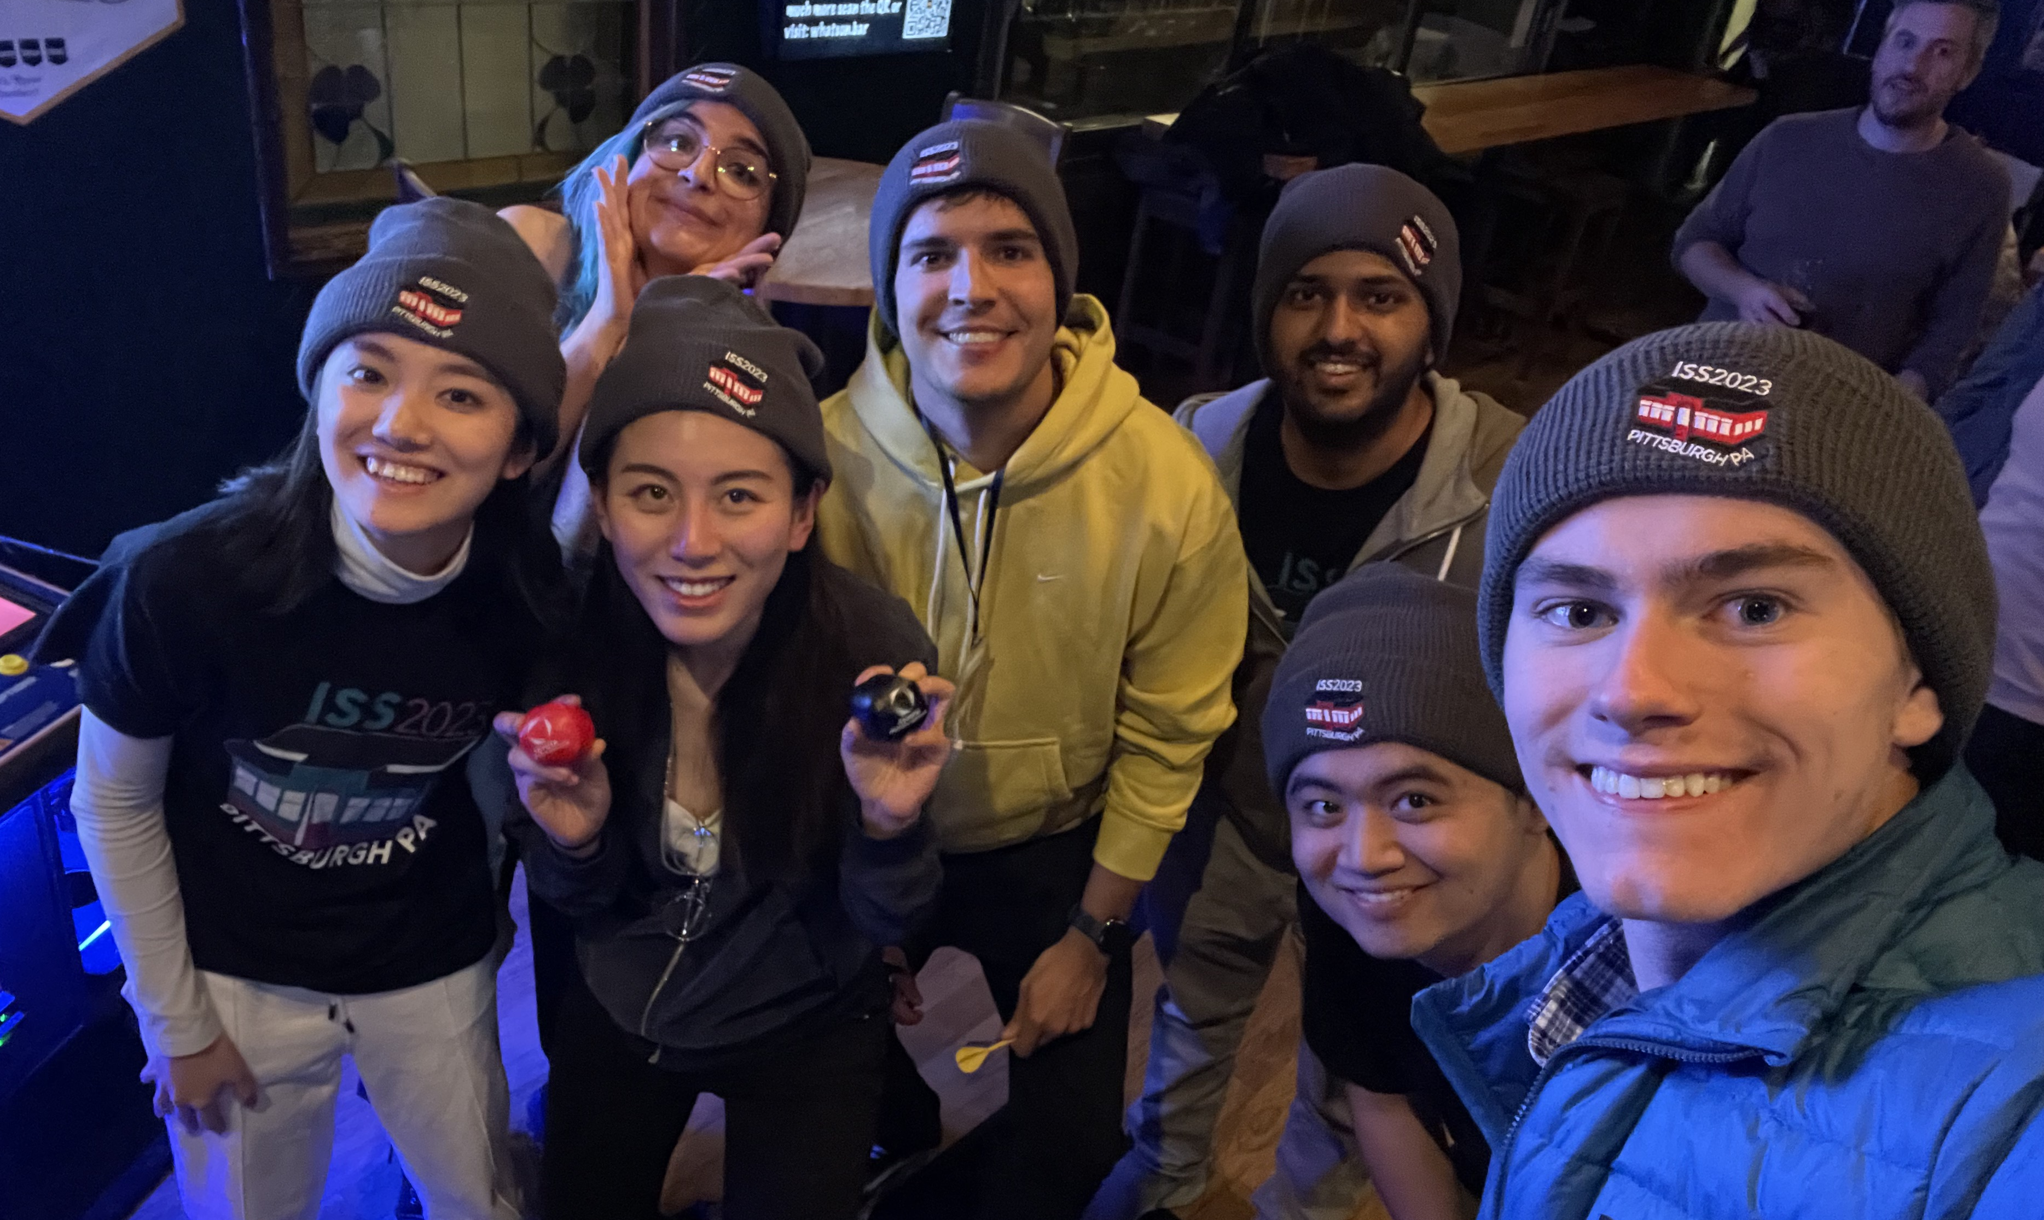
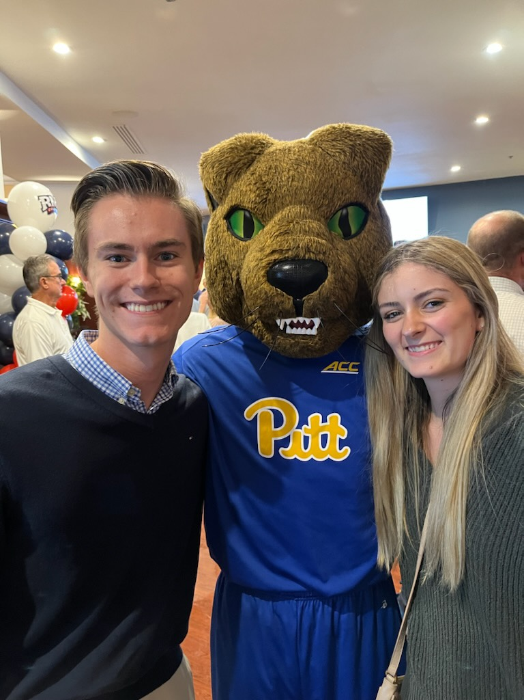
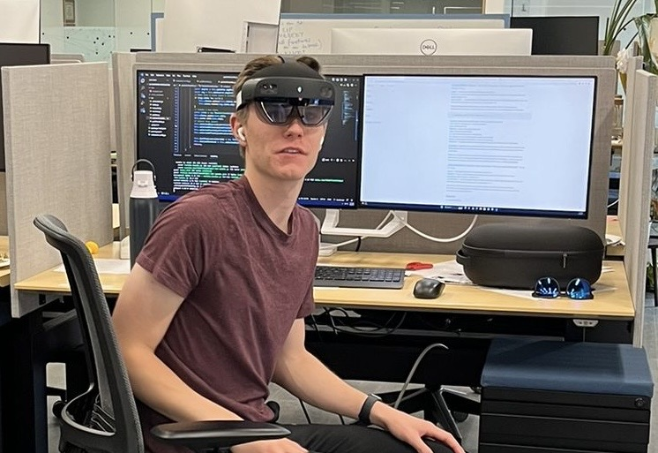
TA Introduction
Griffin Hurt
Senior in CS
Research Medical Applications of Mixed Reality
TA for
CMPINF 0010: Big Ideas in Computing and Information
CS 0449: Introduction to System Software (this course)
griffhurt@pitt.edu
preface subject line with ‘[CMPINF 0010]’
Lab Materials will be posted on my website (once I update it)

Slide 3
TA Office Hours
Day | Time/Location
Tuesday | 11:00 AM - 2:00 PM @ 130 N Bellefield Ave., 5th Floor
Another Time | TBA
By appointment | Message me to schedule a meeting (in-person/virtual)
Changes to office hours will be announced on Canvas

Slide 4
Getting J upterHub
What is the SCI JupyterHub?
Supercomputer with a unified development environment
This means everyone gets the same technology!
Web based, so you don’t need to download anything
Operates on its own filesystem
You get your own storage, and everything will stay there
Other options for JupyterHub
Install it locally (hard mode)
Come to my office hours if you want help with environment setup
Use Binder, which is similar to SCI JupyterHub but not run by Pitt

Slide 5
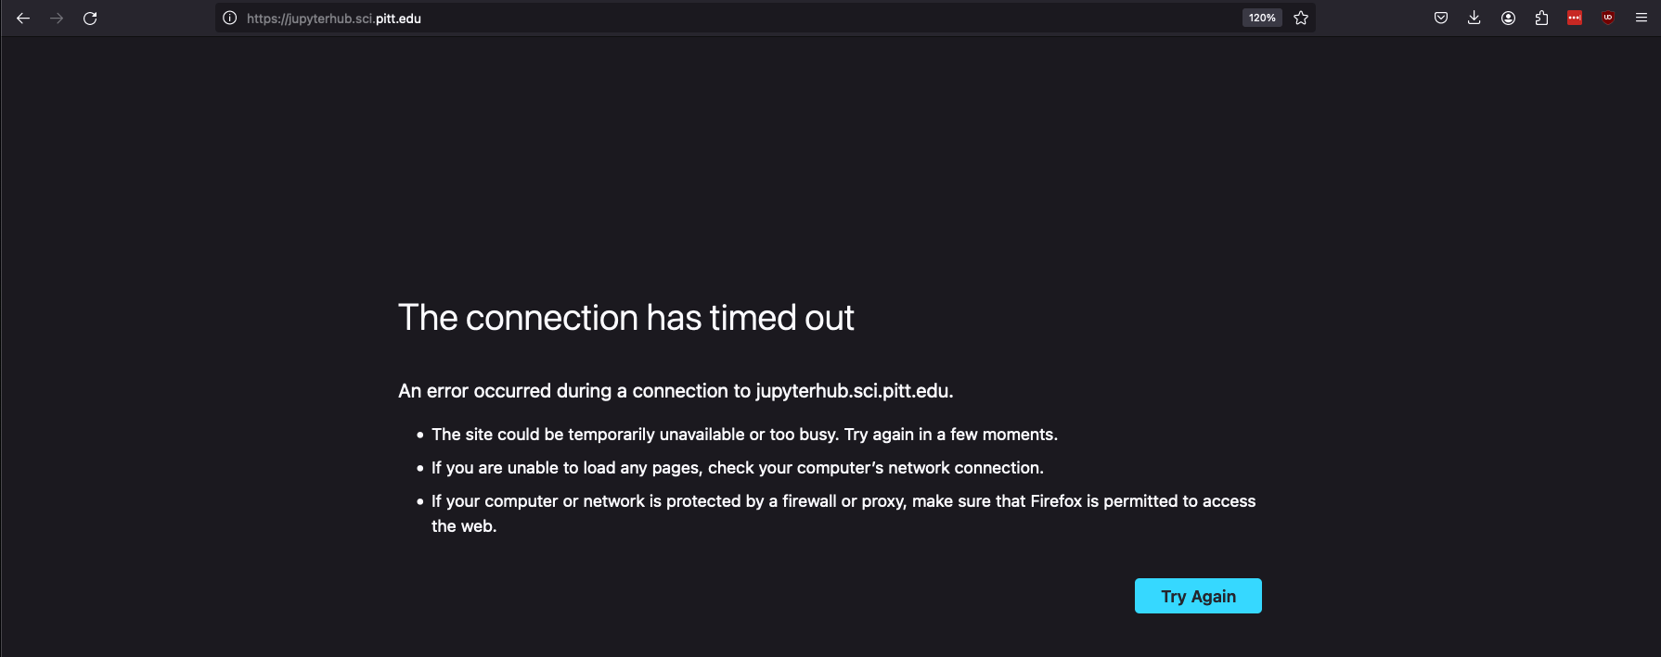
Logging into J upyterHub
I’d love to show you but…
JupyterHub has been down for a week, and I don’t know what’s going on
So, we’re going to use the backup option today: Binder

Slide 6
S tarting J upyterHub
Navigate to the Lab Repository (posted on Canvas)
Click the “Introduction to Jupyter” link

Slide 7
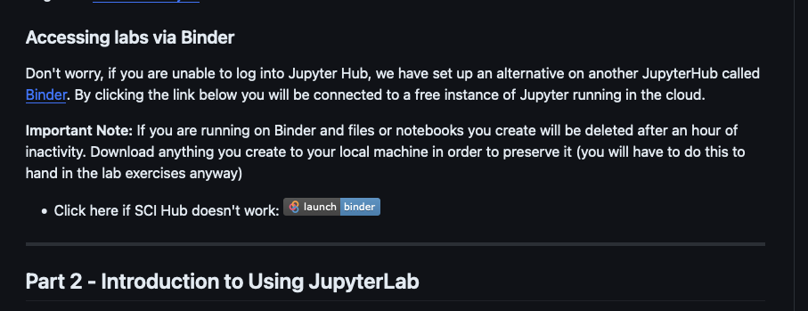
S tarting J upyterHub (cont.)
Scroll down in the repository
Click “launch binder”
We’ll continue our lesson there!

