Slide 1
Lab 2: Python Part 1
Big Ideas in Computing and Information
Griffin Hurt
Griffin Hurt
Undergraduate Teaching Fellow
griffhurt@pitt.edu
https://griffinhurt.com
Spring 2024, Term 2244
Friday 11 AM Lab
Jan 26th, 2024
Slides adapted from
Shinwoo Kim, Martha Dixon, and Vinicius Petrucci
Department of Computer Science
School of Computing & Information
University of Pittsburgh
Using JupyterHub
Values and Types
Variables
Operators
User Input
Changing Data Types
Exception Handling
Control Flow

Slide 2
Updated TA Office Hours
Day | Time/Location
Monday | 1:00PM – 2:30PM @ 130 N Bellefield, 5th Floor or Zoom
Tuesday | 11:00 AM - 2:00 PM @ 130 N Bellefield, 5th Floor or Zoom
Thursday | 4:00 PM – 5:30 PM @ Zoom only
By appointment | Message me to schedule a meeting (in-person/virtual)
Teaching materials (slides/helpful links) are on my website:
https://griffinhurt.com/teaching/

Slide 3
Getting J upterHub
How to log into JupyterHub (it’s working this week!)
If you are not on Pitt wifi, connect to the VPN. If you need help, instructions are here
Alternatively, you can connect virtually to one of Pitt's machines using these instructions
Go to https://jupyterhub.sci.pitt.edu.
Log in with your Pitt credentials
Note: don't inlcude @pitt.edu, and your username needs to be all lowercase (e.g. abc12 is good, but ABC12 and abc12@pitt.edu are not)
Verify yourself with Two Factor Authentication
Click “Start my Server”
Select Host Process from the dropdown (should be default), then hit Spawn
That’s it, you’re in

Slide 4
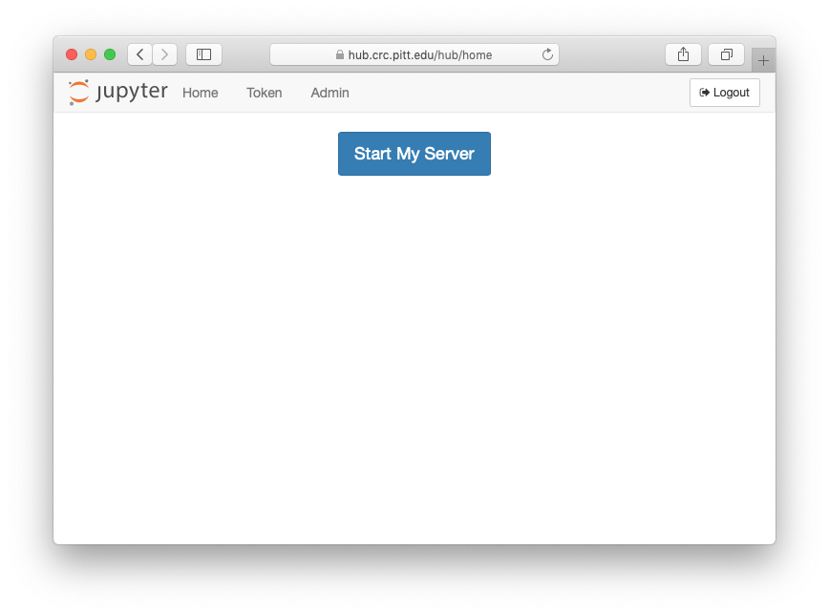
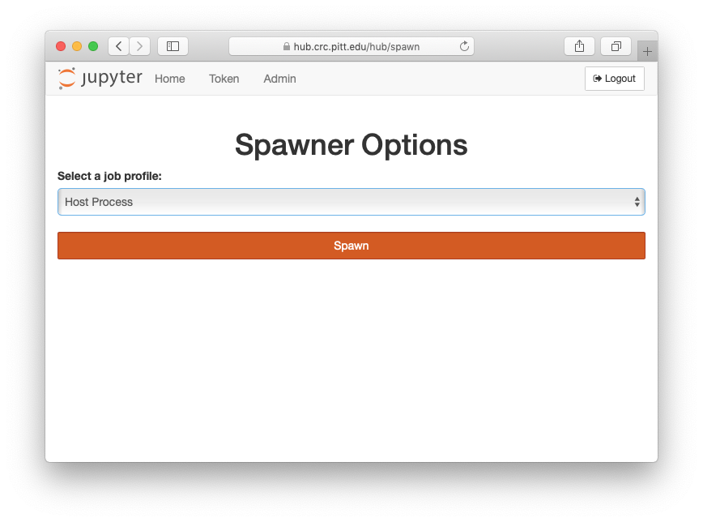
Getting J upyterHub (continued)

Slide 5
Getting the Lab
Navigate to the Lab Repository (posted on Canvas)
Click the “Python Part 1” link, then “Python Part 1”

Slide 6
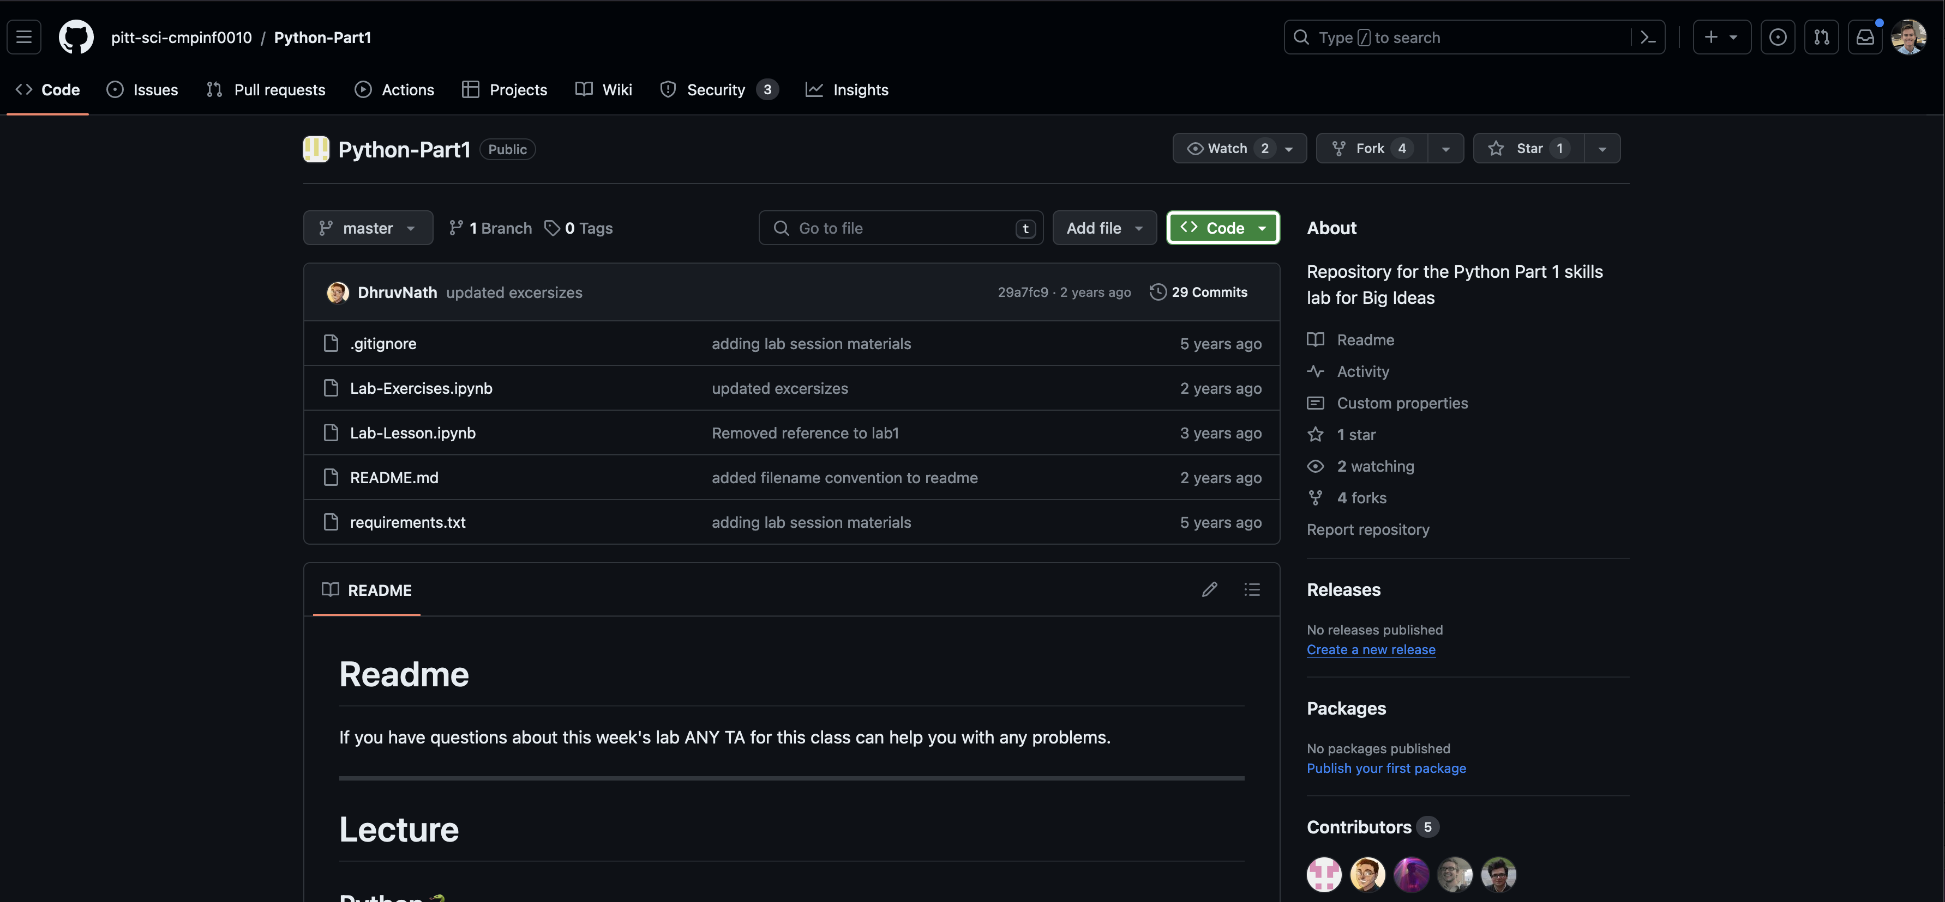
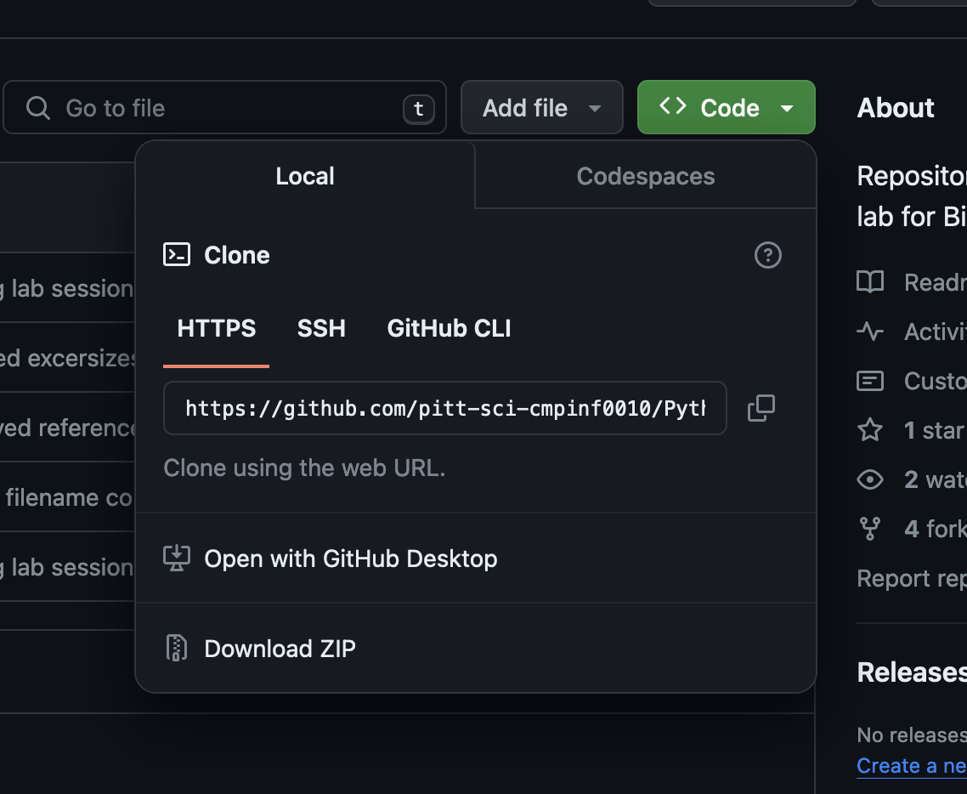
Getting the Lab (cont.)

Slide 7
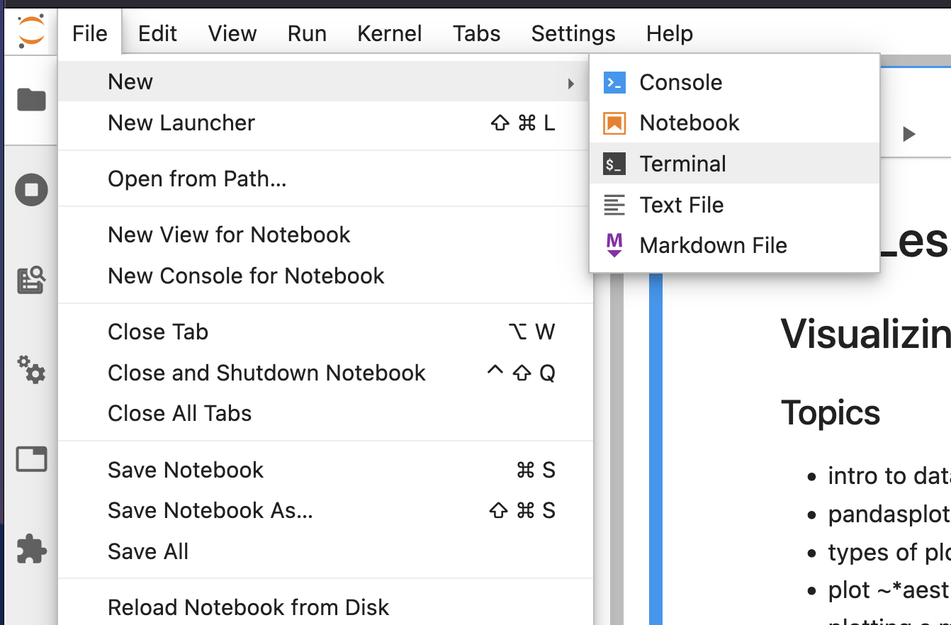
Getting the Lab (cont.)

Slide 8
Getting the Lab (cont.)
git clone <paste link here>
Press enter

Slide 9
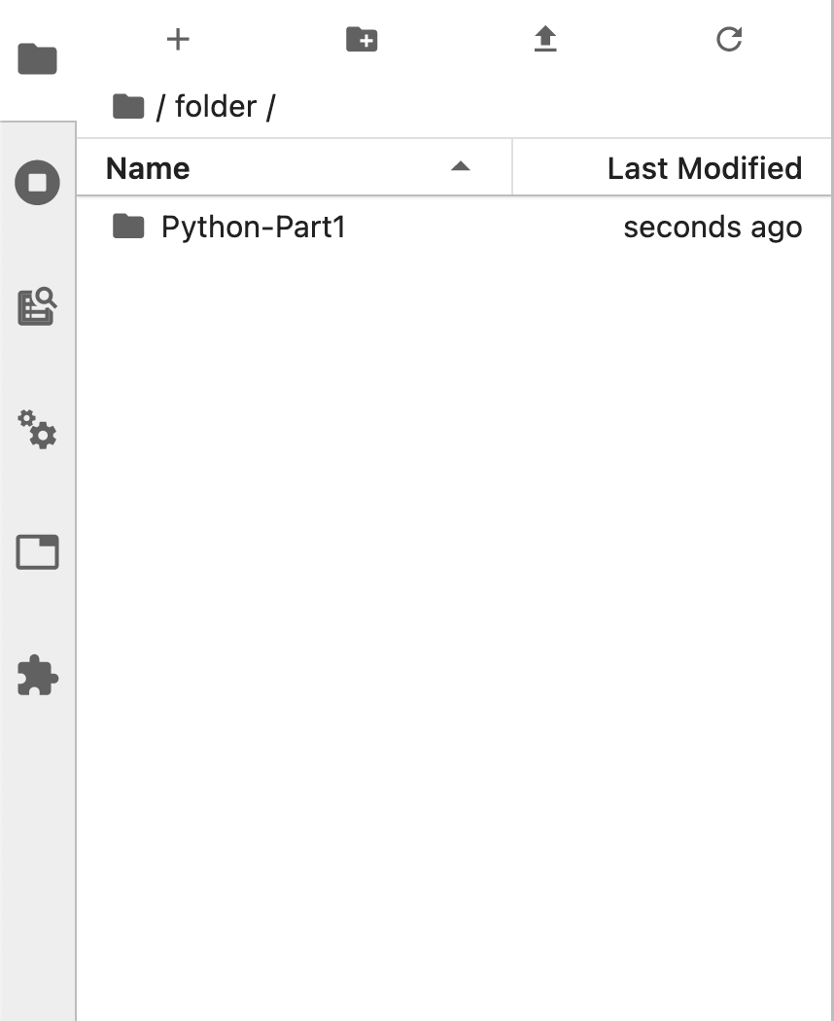
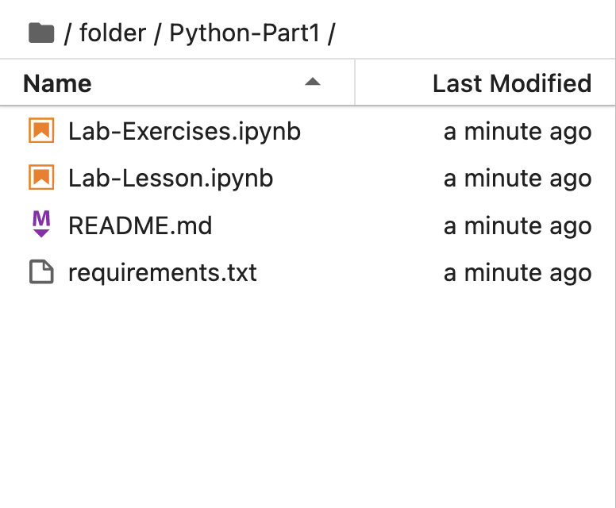
Getting the Lab (cont.)

Slide 10
Now to J upyterHub!
We will continue the lesson in the lab notebook!

