Slide 1
Recitation 6: Assembly
CS 0449: Introduction to Systems Software
Griffin Hurt
Griffin Hurt
Undergraduate Teaching Fellow
griffhurt@pitt.edu
https://griffinhurt.com
Spring 2024, Term 2244
Friday 2 PM Recitation
Feb 23rd, 2024
Slides adapted from
Shinwoo Kim, Martha Dixon, and Vinicius Petrucci
Department of Computer Science
School of Computing & Information
University of Pittsburgh
Agenda
Course News
Assembly
Quiz
Malloc or Quiz 4, your call!

Slide 2
Agenda
Course News!
Assembly Overview
Quiz
Let’s take a poll…
Lab 4 or Malloc?

Slide 3
Course News
Lab 4 (Assembly Lab) is out, due February 29th at 5:59PM
Consider coming to my Monday or Tuesday office hours (The line gets long on Thursdays)
Malloc Project due Monday March 4th at 5:59PM
It’s a doozy, start early please!

Slide 4
Assembly Language
Because decoding 1s and 0s is hard
Notes:
Assembly language is a low-level programming language that is a human-readable representation of the machine code instructions executed by a computer's central processing unit (CPU)
Programs written in assembly language are typically translated into machine code using an assembler. The assembler converts human-readable assembly code into binary machine code that the CPU can execute.

Slide 5
What we are building towards…
gcc hello.c
Any additional libraries get “linked” in here (e.g., stdio.h)
C source
Preprocessed source
Object
files
Executable
hello.c
cpp
Preprocessed
hello.c
cc1
hello.o
ld
hello
Preprocessor
gcc -E hello.c
Compiler
gcc -c hello.c
Linker
gcc -u hello hello.o
gcc -S hello.c
Assembly code
hello.s
Notes:
clang -S sourcefile.c
Produces assembly code in sourcefile.s
clang -c sourcefile.c
Produce object file (binary machine code) in sourcefile. This is the more common option to employ for the compilation stage. When all source files have been compiled to object code (.o files), all the .o files can be linked to produce a binary executable program.

Slide 6
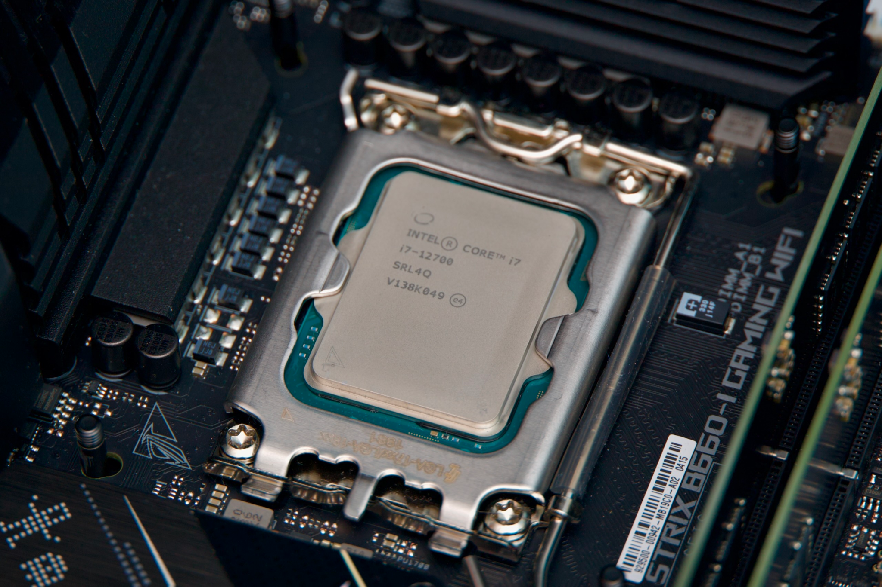
Moving down the ladder of abstractions
Application level (Word, Zoom, Firefox)
Very abstract
car *c = malloc(sizeof(car));
c->miles = 100;
float mpg = get_mpg(c);
free(c);
High-level language level (C, Java)
get_mpg:
pushq %rbp
movq %rsp, %rbp
...
popq %rbp
ret
Assembly language level (x86)
Level of abstraction
0111010000011000100011010000010000000010100010011100001011000001111110100001111110001001110000101000100111000010100010100010
Machine language level
Operating system level (Linux, Windows, macOS)
Not abstract
Hardware level

Slide 7
What is assembly?
Assembly language is a human-readable textual representation of machine language
High-level language (C, Java)
car *c = malloc(sizeof(car));
c->miles = 100;
c->gals = 17;
float mpg = get_mpg(c);
free(c);
^{Relatively} Easy for us to understand
Assembly acts as a translator between high-level code and machine code
get_mpg:
pushq %rbp
movq %rsp, %rbp
...
popq %rbp
ret
Machine language
011101000001100010001101000001000000001010001001110000101100000111111010000111111100000111111010000111111100
Easy for computer to understand

Slide 8
Keeping track of the registers
Like in MIPS, x86 has calling conventions
The C Application Binary Interface (ABI)
Like MIPS, certain registers are typically used for returns values, args, etc
The ABI is not defined by the language, but rather the OS
Windows and Linux (UNIX/System V) have a different C ABI
In our x86-64 Linux C ABI,
%rdi, %rsi, %rdx, %rcx, %r8, %r9 are used to pass arguments (like the a registers in MIPS)
Remaining arguments go on the stack
A function callee must preserve %rbp, %rbx, %r12, %r13, %r14, %r15 (like the s registers in MIPS)
%rax (overflows into %rdx for 128-bits) stores the return value (like v0, v1 in MIPS)
Reference manual provides extra information
Notes:
The C Application Binary Interface (ABI) is a set of conventions, rules, and guidelines for how programs written in the C programming language should interact with each other at the binary level.

Slide 11
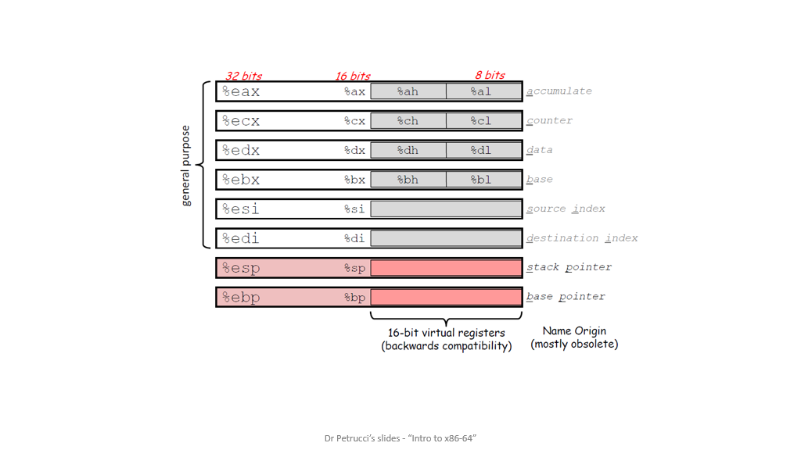

Slide 17
Will I have to write assembly code for this course?
No! No matter how good you are at programming, you are no match for a modern compiler
^{Modern} Compilers are just too good at optimization
There was a time when humans outperformed compilers
Those days are long gone now…
However, you should be able to read assembly code
To figure out what your machine is doing
To guess the C code
By the end of this lab, you should be able to freely translate assembly and C

Slide 18
Quiz time!
Password is _________

Slide 19
Diving into the Code!
See code: https://github.com/shinwookim/asm-demo

Slide 20
Hello World! ^{x86 edition}
#include <stdio.h>
int main(void)
{
puts("Hello World!");
return 0;
}
.LC0:
.string "Hello World!"
main:
pushq %rbp
movq %rsp, %rbp # rsp = stack pointer
movl $.LC0, %edi # push func args
call puts # call a function
movl $0, %eax # eax = return register
popq %rbp # prepare to return
ret # return
text (code) segment:
55 48 89 E5 BF 00 00 00 00 E8 00 00 00 00 B8 00 00 00 00 5D C3
data segment:
48 65 6C 6C 6F 2C 20 57 6F 72 6C
// Symbol table and other info omitted
Linker
Executable
Notes:
Von Neumann Architecture → Code and data live on the same memory
RBP is frame pointer (stores a copy of rsp when we enter function)
RSP stack pointer

Slide 21
Debugging Assembly
Recall that GDB worked on executables
You ran gdb mdriver and not gdb mdriver.c
Having the source was nice
We used the -g flag when compiling
which allowed us to use layout src to view the code during execution
…but not necessary
What if we don’t have a source file ? (or the program was compiled without -g flag)
We can still run GDB!
Won’t be able to see the source code ⇒ We need to inspect assembly code
Reading symbols from a.out...
(No debugging symbols found in a.out)

Slide 22
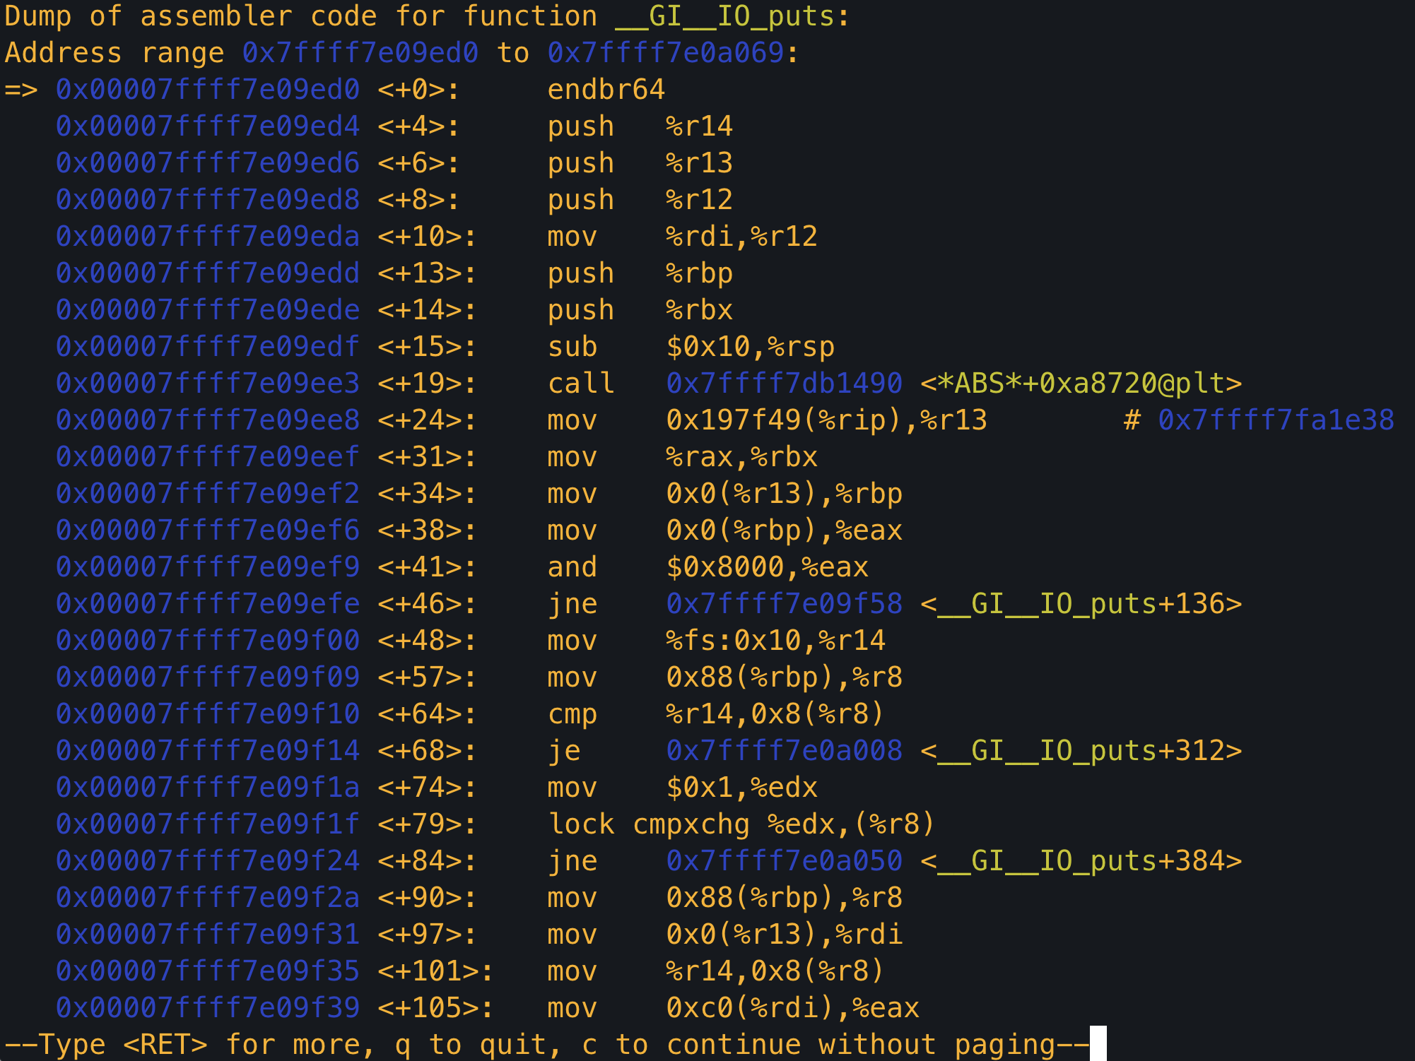
Displaying the assembly with disas
Suppose we are in paused in a breakpoint
We can view the assembly code around our current memory address using disas
Memory address that is held by the program counter
But how do we set a breakpoint
if we don’t have the code?
Surely, we need a way to view ASM
Without first setting a breakpoint right?
Notes:
Breakpoint on puts then disas

Slide 23
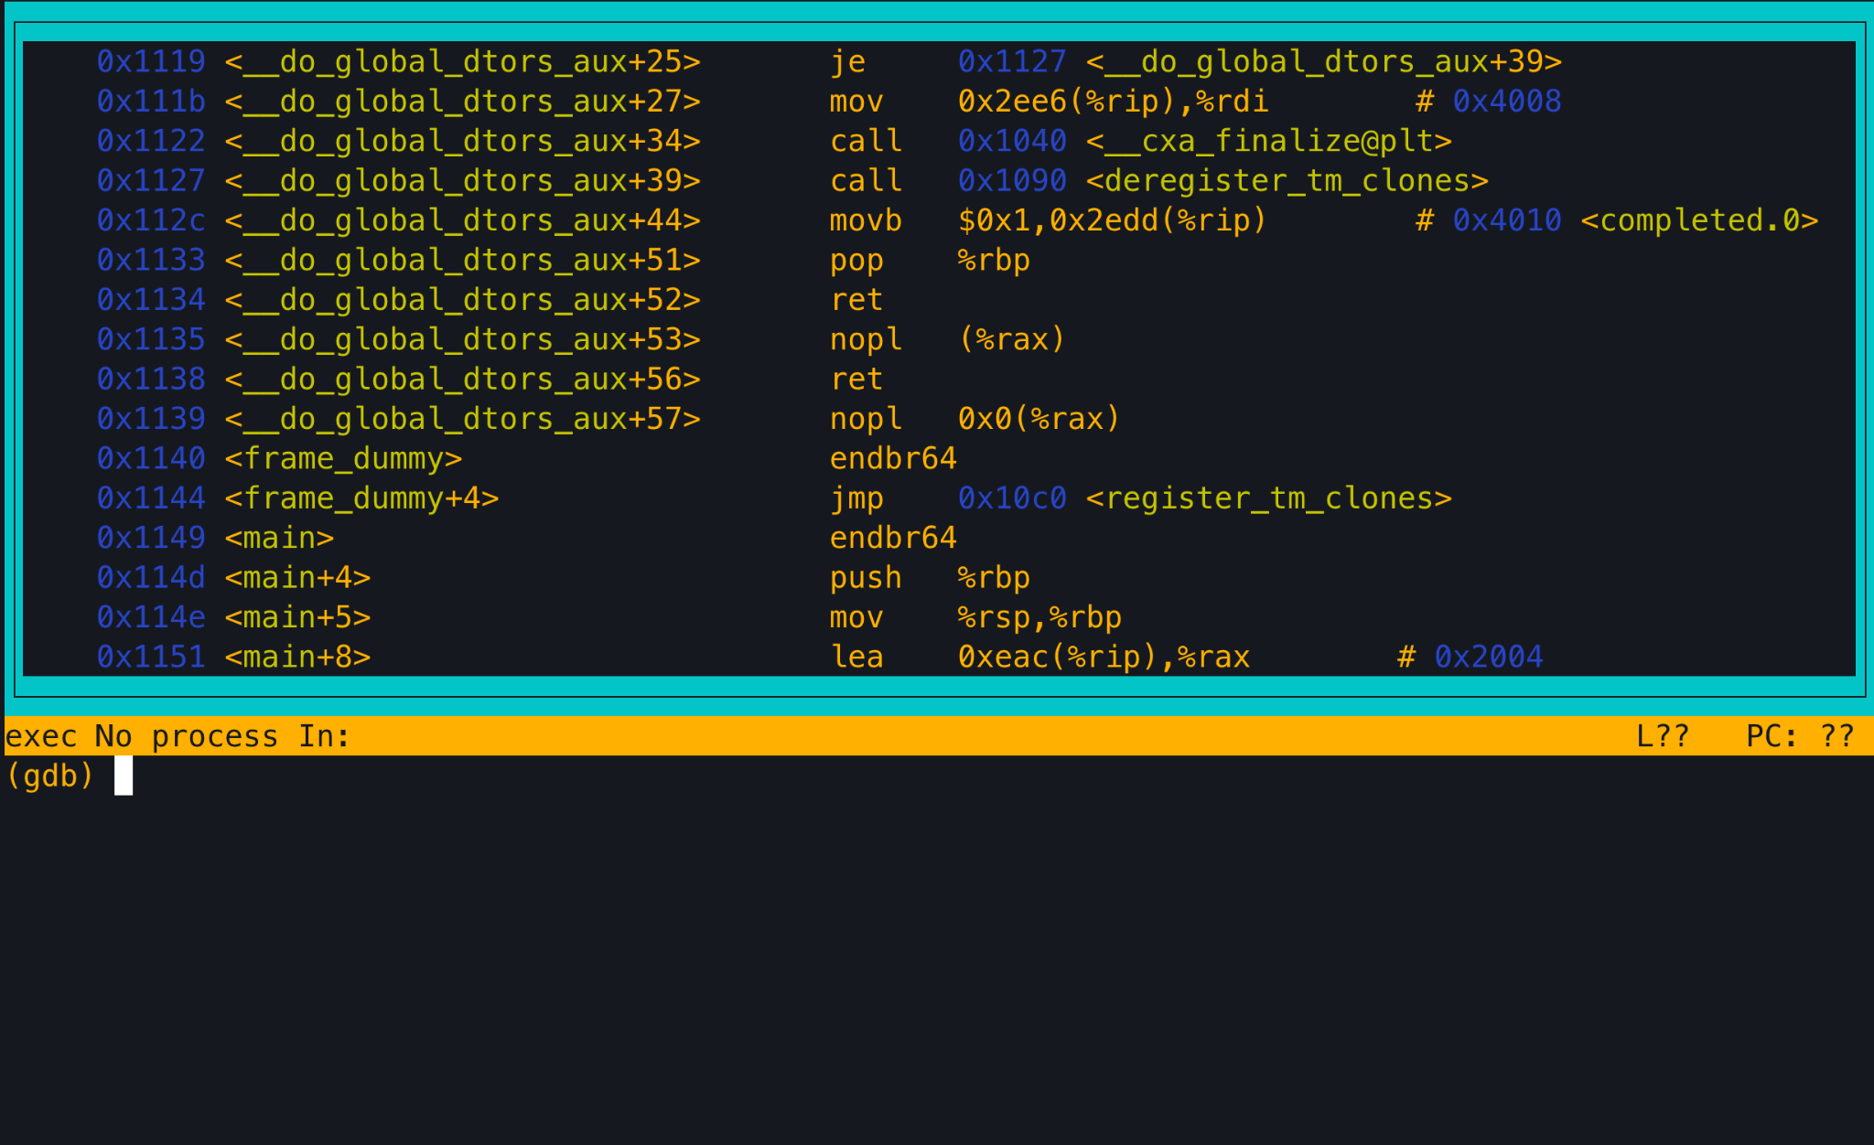
Displaying the assembly with layout asm
The layout asm command displays the assembly of the entire program
You can scroll through the code and identify the memory addresses to set breakpoints
But what if your program is Huuuuge?
That’s gonna be a lot of scrolling
Notes:
Personally, I don’t like this approach

Slide 24
Let’s put the asm in a file ⇒ Now we can ctrl+f
objdump -d program > program.s
GNU provides a tool called object dump for unix-like systems
Let’s you inspect information from object files
The -d flag disassembles the program and displays the .code section
The > flag redirects your standard I/O output to a file
USER@thoth:$ objdump -d a.out
a.out: file format elf64-x86-64
Disassembly of section .init:
0000000000001000 <_init>:
1000: f3 0f 1e fa endbr64
1004: 48 83 ec 08 sub $0x8,%rsp
1008: 48 8b 05 d9 2f 00 00 mov 0x2fd9(%rip),%rax # 3fe8
100f: 48 85 c0 test %rax,%rax
1012: 74 02 je 1016 <_init+0x16>
1014: ff d0 call *%rax
1016: 48 83 c4 08 add $0x8,%rsp
101a: c3 ret
…
Notes:
.s is the typical stadnard

Slide 25
GDB Assembly Edition
Back to GDB…
You can still set breakpoints
Not at specific lines of code…but at specific instructions (which are stored in memory)
break *0x000055555555515b
Why the *?
*main+24
You can set breakpoints at function offsets
Get this from GDB’s layout asm
You can still step through your code
Again, not stepping through lines of code, but through CPU instructions
Using stepi instead of step
nexti instead of next
Continue
Notes:
Next runs entire subroutine

Slide 26
GDB Assembly Edition
Examining Memory
We can print values stored at memory address or at registers
print/format expr
Indicate registers with $ (NOT %)
To print a value stor`ed in a memory address use *
format tells us how to interpret values at that memory location
d: decimal
x:hex
t: binary
f: floating point
i: instruction
c: character
p $rdi displays the content at %rdi in a decimal format
x MEM_ADDR prints memory content
Just because you print it as decimal does not mean that the value is a decimal
Interpretation of values depends on the context (which you need to provide)
info registers lets you see all registers at once
Notes:
Next runs entire subroutine

Slide 27
Need help with GDB?
Come to office hours!

Slide 28
C Control Structures → Assembly
#include <stdio.h>
int main(void)
{
for (int i = 0; i < 10; i++)
{
printf("%d", i);
}
return 0;
}
0x0000000000001155 <+12>: movl $0x0,-0x4(%rbp)
0x000000000000115c <+19>: jmp 0x117b <main+50>
0x000000000000115e <+21>: mov -0x4(%rbp),%eax
0x0000000000001161 <+24>: mov %eax,%esi
0x0000000000001163 <+26>: lea 0xe9a(%rip),%rax
0x000000000000116a <+33>: mov %rax,%rdi
0x000000000000116d <+36>: mov $0x0,%eax
0x0000000000001172 <+41>: call 0x1050 <printf@plt>
0x0000000000001177 <+46>: addl $0x1,-0x4(%rbp)
0x000000000000117b <+50>: cmpl $0x9,-0x4(%rbp)
0x000000000000117f <+54>: jle 0x115e <main+21>
Notes:
i is stored on the stack
This line initializes a local variable to 0 and stores it at the memory location -0x4(%rbp). The purpose is to initialize a counter variable for a loop.
This is an unconditional jump, and it effectively skips the lines between this jump and the next. It's a branch to the loop condition check, which is 0x000000000000117b.
This instruction loads the value from the memory location -0x4(%rbp) (the counter) into the %eax register. This is likely part of preparing an argument for a function call (e.g., printf).
The value from %eax (which holds the counter) is moved to the %esi register. This could be part of the argument setup for a function call.
This is a "Load Effective Address" instruction. It computes the address of the instruction 0xe9a bytes ahead of the current instruction and stores it in the %rax register.
The value from %rax is moved to the %rdi register. Like the previous instructions, this is setting up registers for a function call (likely printf).
This instruction sets %eax to 0. This might be preparing an argument for a function or resetting a register value for further use
This is a function call to printf@plt. %rdi is probably set as the format string, %rsi as the first argument, and %rax (which was set to 0) as the return value. The printf function is likely being called to print the value in %esi.
This instruction increments the value at -0x4(%rbp) (the counter) by 1. It's part of the loop control mechanism, incrementing the counter for the next iteration.
This is a comparison operation, comparing the value at -0x4(%rbp) (the counter) with 9. This comparison is likely used to check if the loop should continue (if the counter is less than or equal to 9).
This is a conditional jump instruction. If the previous comparison (cmpl) results in the counter being less than or equal to 9, the program jumps back to 0x115e, effectively restarting the loop.

Slide 29
C Control Structures → Assembly
#include <stdio.h>
int main(void)
{
int i = 0;
while (i < 10)
{
printf("%d", i);
i++;
}
return 0;
}
0x0000000000001155 <+12>: movl $0x0,-0x4(%rbp)
0x000000000000115c <+19>: jmp 0x117b <main+50>
0x000000000000115e <+21>: mov -0x4(%rbp),%eax
0x0000000000001161 <+24>: mov %eax,%esi
0x0000000000001163 <+26>: lea 0xe9a(%rip),%rax
0x000000000000116a <+33>: mov %rax,%rdi
0x000000000000116d <+36>: mov $0x0,%eax
0x0000000000001172 <+41>: call 0x1050 <printf@plt>
0x0000000000001177 <+46>: addl $0x1,-0x4(%rbp)
0x000000000000117b <+50>: cmpl $0x9,-0x4(%rbp)
0x000000000000117f <+54>: jle 0x115e <main+21>
Notes:
i is stored on the stack
This line initializes a local variable to 0 and stores it at the memory location -0x4(%rbp). The purpose is to initialize a counter variable for a loop.
This is an unconditional jump, and it effectively skips the lines between this jump and the next. It's a branch to the loop condition check, which is 0x000000000000117b.
This instruction loads the value from the memory location -0x4(%rbp) (the counter) into the %eax register. This is likely part of preparing an argument for a function call (e.g., printf).
The value from %eax (which holds the counter) is moved to the %esi register. This could be part of the argument setup for a function call.
This is a "Load Effective Address" instruction. It computes the address of the instruction 0xe9a bytes ahead of the current instruction and stores it in the %rax register.
The value from %rax is moved to the %rdi register. Like the previous instructions, this is setting up registers for a function call (likely printf).
This instruction sets %eax to 0. This might be preparing an argument for a function or resetting a register value for further use
This is a function call to printf@plt. %rdi is probably set as the format string, %rsi as the first argument, and %rax (which was set to 0) as the return value. The printf function is likely being called to print the value in %esi.
This instruction increments the value at -0x4(%rbp) (the counter) by 1. It's part of the loop control mechanism, incrementing the counter for the next iteration.
This is a comparison operation, comparing the value at -0x4(%rbp) (the counter) with 9. This comparison is likely used to check if the loop should continue (if the counter is less than or equal to 9).
This is a conditional jump instruction. If the previous comparison (cmpl) results in the counter being less than or equal to 9, the program jumps back to 0x115e, effectively restarting the loop.

Slide 30
C Control Structures → Assembly
#include <stdio.h>
int main(void)
{
for (int i = 0; i < 10; i++)
{
printf("%d", i);
}
return 0;
}
0x0000000000001155 <+12>: movl $0x0,-0x4(%rbp)
0x000000000000115c <+19>: jmp 0x117b <main+50>
0x000000000000115e <+21>: mov -0x4(%rbp),%eax
0x0000000000001161 <+24>: mov %eax,%esi
0x0000000000001163 <+26>: lea 0xe9a(%rip),%rax
0x000000000000116a <+33>: mov %rax,%rdi
0x000000000000116d <+36>: mov $0x0,%eax
0x0000000000001172 <+41>: call 0x1050 <printf@plt>
0x0000000000001177 <+46>: addl $0x1,-0x4(%rbp)
0x000000000000117b <+50>: cmpl $0x9,-0x4(%rbp)
0x000000000000117f <+54>: jle 0x115e <main+21>
Wait….why is the assembly code the same?
Notes:
i is stored on the stack
This line initializes a local variable to 0 and stores it at the memory location -0x4(%rbp). The purpose is to initialize a counter variable for a loop.
This is an unconditional jump, and it effectively skips the lines between this jump and the next. It's a branch to the loop condition check, which is 0x000000000000117b.
This instruction loads the value from the memory location -0x4(%rbp) (the counter) into the %eax register. This is likely part of preparing an argument for a function call (e.g., printf).
The value from %eax (which holds the counter) is moved to the %esi register. This could be part of the argument setup for a function call.
This is a "Load Effective Address" instruction. It computes the address of the instruction 0xe9a bytes ahead of the current instruction and stores it in the %rax register.
The value from %rax is moved to the %rdi register. Like the previous instructions, this is setting up registers for a function call (likely printf).
This instruction sets %eax to 0. This might be preparing an argument for a function or resetting a register value for further use
This is a function call to printf@plt. %rdi is probably set as the format string, %rsi as the first argument, and %rax (which was set to 0) as the return value. The printf function is likely being called to print the value in %esi.
This instruction increments the value at -0x4(%rbp) (the counter) by 1. It's part of the loop control mechanism, incrementing the counter for the next iteration.
This is a comparison operation, comparing the value at -0x4(%rbp) (the counter) with 9. This comparison is likely used to check if the loop should continue (if the counter is less than or equal to 9).
This is a conditional jump instruction. If the previous comparison (cmpl) results in the counter being less than or equal to 9, the program jumps back to 0x115e, effectively restarting the loop.

Slide 31
for loops == while loops!
Your CPU treats them the same way!
* do-while loops also work the same way (Write a short program and inspect the assembly!)

Slide 32
C Control Structures → Assembly
#include <stdio.h>
int main(void)
{
int input;
scanf("%d", &input);
if (input > 10) printf("Big");
else printf("Not Big");
return 0;
}
11bf: 8b 45 f4 mov -0xc(%rbp),%eax
11c2: 83 f8 0a cmp $0xa,%eax
11c5: 7e 16 jle 11dd <main+0x54>
11c7: 48 8d 05 39 0e 00 00 lea 0xe39(%rip),%rax
11ce: 48 89 c7 mov %rax,%rdi
11d1: b8 00 00 00 00 mov $0x0,%eax
11d6: e8 a5 fe ff ff call 1080 <printf@plt>
11db: eb 14 jmp 11f1 <main+0x68>
11dd: 48 8d 05 27 0e 00 00 lea 0xe27(%rip),%rax
11e4: 48 89 c7 mov %rax,%rdi
11e7: b8 00 00 00 00 mov $0x0,%eax
11ec: e8 8f fe ff ff call 1080 <printf@plt>
Notes:
Layout split demo

Slide 33
Conditional statements works as expected
Who knew that if-else executed different based on conditions?

Slide 35
Our real first assembly code analysis
Looking through a real program!
Special thanks to Jake Kasper for providing slides & code

Slide 36
C Control Structures → Assembly
#include <stdio.h>
int main(int argc, char **argv)
{
int myNum = increment(5);
printf("My num is %d\n", myNum);
return 0;
}
int increment(int num)
{
return ++num;
}
0000000000001149 <main>:
1149: f3 0f 1e fa endbr64
114d: 55 push %rbp
114e: 48 89 e5 mov %rsp,%rbp
1151: 48 83 ec 20 sub $0x20,%rsp
1155: 89 7d ec mov %edi,-0x14(%rbp)
1158: 48 89 75 e0 mov %rsi,-0x20(%rbp)
115c: bf 05 00 00 00 mov $0x5,%edi
1161: e8 23 00 00 00 call 1189<increment>
1166: 89 45 fc mov %eax,-0x4(%rbp)
(…)
Prefix increment
Increments first, then returns
Notes:
Layout split demo

Slide 37
C Control Structures → Assembly
#include <stdio.h>
int main(int argc, char **argv)
{
int myNum = increment(5);
printf("My num is %d\n", myNum);
return 0;
}
int increment(int num)
{
return ++num;
}
0000000000001189 <increment>:
1189: f3 0f 1e fa endbr64
118d: 55 push %rbp
118e: 48 89 e5 mov %rsp,%rbp
1191: 89 7d fc mov %edi,-0x4(%rbp)
1194: 83 45 fc 01 addl $0x1,-0x4(%rbp)
1198: 8b 45 fc mov -0x4(%rbp),%eax
119b: 5d pop %rbp
119c: c3 ret
Notes:
Layout split demo

Slide 38
C Control Structures → Assembly
%rbp needs maintains the current stack frame
To preserve the previous stack frame
it gets pushed onto the stack
#include <stdio.h>
int main(int argc, char **argv)
{
int myNum = increment(5);
printf("My num is %d\n", myNum);
return 0;
}
int increment(int num)
{
return ++num;
}
0000000000001189 <increment>:
1189: f3 0f 1e fa endbr64
118d: 55 push %rbp
118e: 48 89 e5 mov %rsp,%rbp
1191: 89 7d fc mov %edi,-0x4(%rbp)
1194: 83 45 fc 01 addl $0x1,-0x4(%rbp)
1198: 8b 45 fc mov -0x4(%rbp),%eax
119b: 5d pop %rbp
119c: c3 ret
Notes:
RBP stores the start of the stack for this function

Slide 39
C Control Structures → Assembly
%edi is our first argument register, so we’re moving the value of our argument (num) into the current stack frame
#include <stdio.h>
int main(int argc, char **argv)
{
int myNum = increment(5);
printf("My num is %d\n", myNum);
return 0;
}
int increment(int num)
{
return ++num;
}
Why -0x4?
0000000000001189 <increment>:
1189: f3 0f 1e fa endbr64
118d: 55 push %rbp
118e: 48 89 e5 mov %rsp,%rbp
1191: 89 7d fc mov %edi,-0x4(%rbp)
1194: 83 45 fc 01 addl $0x1,-0x4(%rbp)
1198: 8b 45 fc mov -0x4(%rbp),%eax
119b: 5d pop %rbp
119c: c3 ret
Notes:
Size of int is 4 bytes

Slide 40
C Control Structures → Assembly
Increment the value of the argument we just stored in the stack
#include <stdio.h>
int main(int argc, char **argv)
{
int myNum = increment(5);
printf("My num is %d\n", myNum);
return 0;
}
int increment(int num)
{
return ++num;
}
0000000000001189 <increment>:
1189: f3 0f 1e fa endbr64
118d: 55 push %rbp
118e: 48 89 e5 mov %rsp,%rbp
1191: 89 7d fc mov %edi,-0x4(%rbp)
1194: 83 45 fc 01 addl $0x1,-0x4(%rbp)
1198: 8b 45 fc mov -0x4(%rbp),%eax
119b: 5d pop %rbp
119c: c3 ret
Notes:
RBP stores the start of the stack for this function

Slide 41
C Control Structures → Assembly
#include <stdio.h>
int main(int argc, char **argv)
{
int myNum = increment(5);
printf("My num is %d\n", myNum);
return 0;
}
int increment(int num)
{
return ++num;
}
Move our data we’ve been editing in the stack, to our return register
0000000000001189 <increment>:
1189: f3 0f 1e fa endbr64
118d: 55 push %rbp
118e: 48 89 e5 mov %rsp,%rbp
1191: 89 7d fc mov %edi,-0x4(%rbp)
1194: 83 45 fc 01 addl $0x1,-0x4(%rbp)
1198: 8b 45 fc mov -0x4(%rbp),%eax
119b: 5d pop %rbp
119c: c3 ret
Notes:
RBP stores the start of the stack for this function

Slide 42
C Control Structures → Assembly
Pop the stack frame from the stack, as we’re about to return from the current function scope, and this will load the previous stack frame back to %rbp
#include <stdio.h>
int main(int argc, char **argv)
{
int myNum = increment(5);
printf("My num is %d\n", myNum);
return 0;
}
int increment(int num)
{
return ++num;
}
0000000000001189 <increment>:
1189: f3 0f 1e fa endbr64
118d: 55 push %rbp
118e: 48 89 e5 mov %rsp,%rbp
1191: 89 7d fc mov %edi,-0x4(%rbp)
1194: 83 45 fc 01 addl $0x1,-0x4(%rbp)
1198: 8b 45 fc mov -0x4(%rbp),%eax
119b: 5d pop %rbp
119c: c3 ret
Notes:
RBP stores the start of the stack for this function

Slide 43
C Control Structures → Assembly
Return to caller
What about the return value?
It’s already in the return register(%eax)
#include <stdio.h>
int main(int argc, char **argv)
{
int myNum = increment(5);
printf("My num is %d\n", myNum);
return 0;
}
int increment(int num)
{
return ++num;
}
0000000000001189 <increment>:
1189: f3 0f 1e fa endbr64
118d: 55 push %rbp
118e: 48 89 e5 mov %rsp,%rbp
1191: 89 7d fc mov %edi,-0x4(%rbp)
1194: 83 45 fc 01 addl $0x1,-0x4(%rbp)
1198: 8b 45 fc mov -0x4(%rbp),%eax
119b: 5d pop %rbp
119c: c3 ret
Notes:
RBP stores the start of the stack for this function

Slide 44
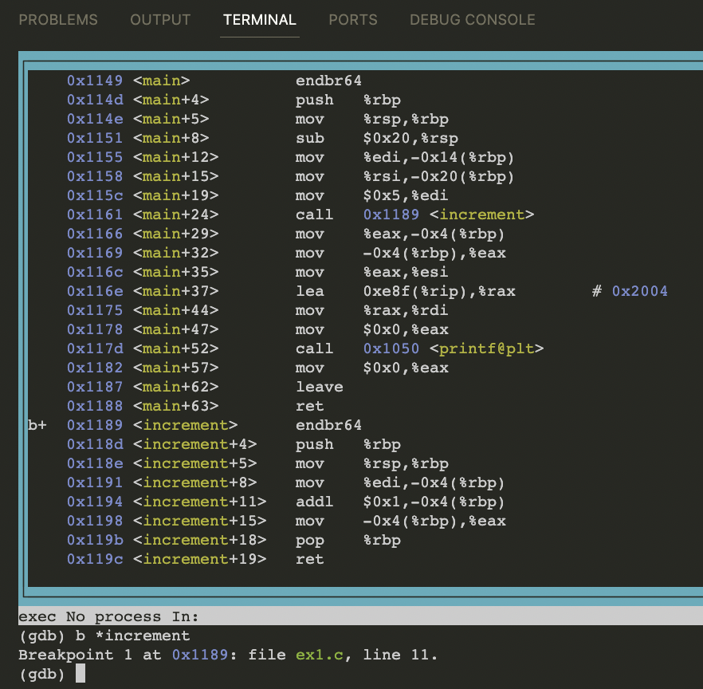
Let’s inspect increment() with GDB
Set a breakpoint at the start of the assembly for increment using the *

Slide 45
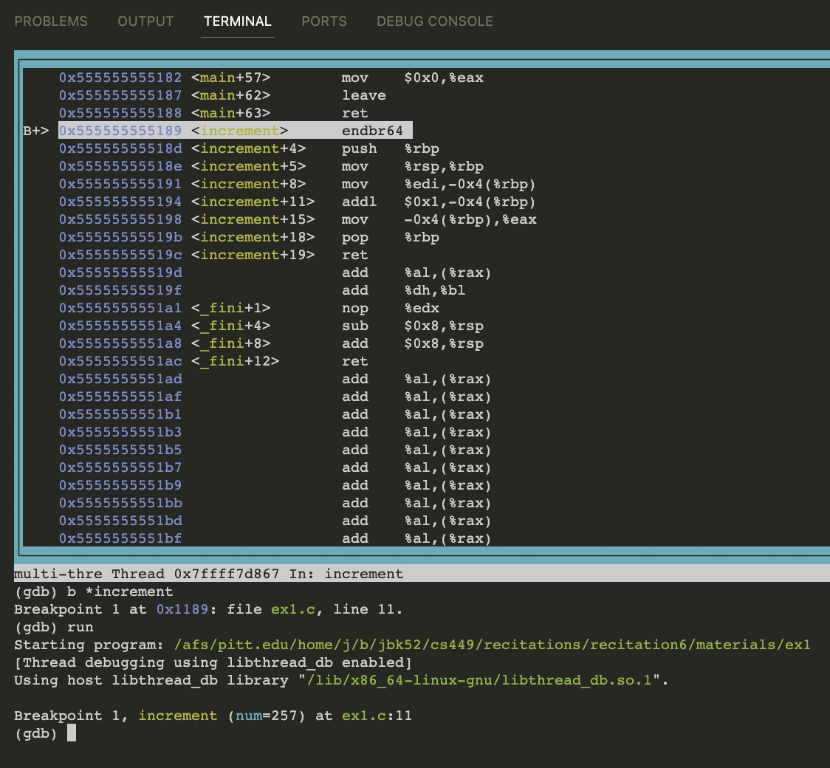
Tracing through the code w/ GDB
After running, we’ve hit the breakpoint at increment
Let’s read the assembly line by line using ni (`next instruction`), though we can skip ahead a few lines until we get to the more important function details

Slide 46
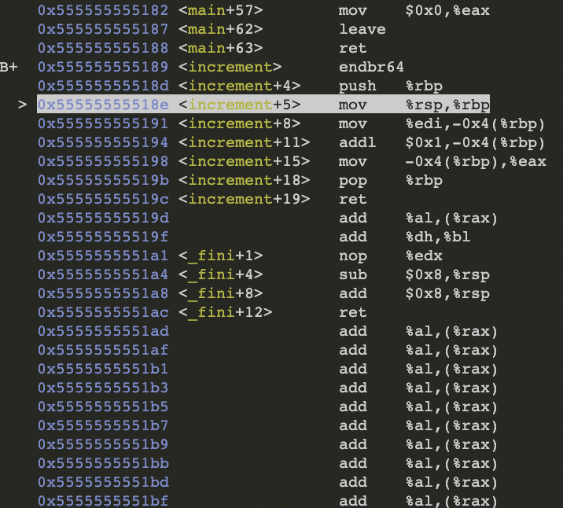
Tracing through the code w/ GDB
This is the line in which our stack frame pointer, %rbp, is being updated to contain the current stack address

Slide 47
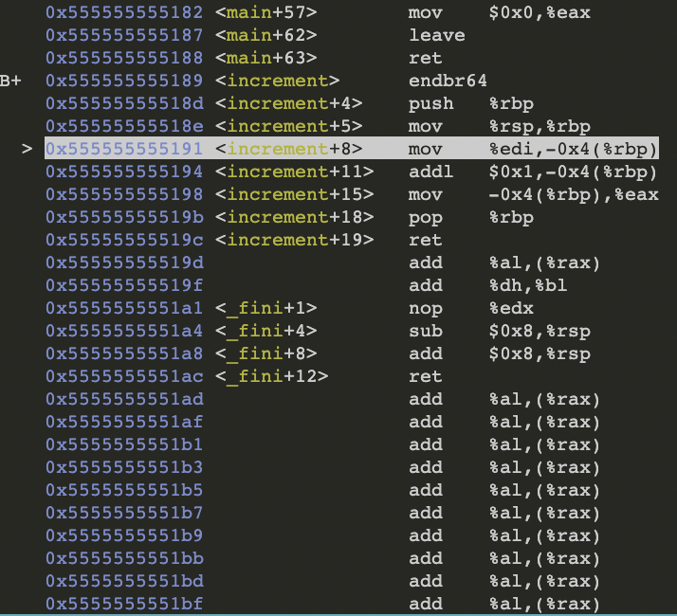
Tracing through the code w/ GDB
We’ve now executed the instruction to add the current stack pointer to %rbp
We are also about to execute the line to put the argument register’s contents into the stack frame, so let’s check the value of the argument register:
p $rdi →
This makes sense, as we passed 5 into our function in our C code
Notes:
When data is pushed onto the stack, the stack pointer is incremented to point to the new top. When data is popped off the stack, the stack pointer is decremented.

Slide 48
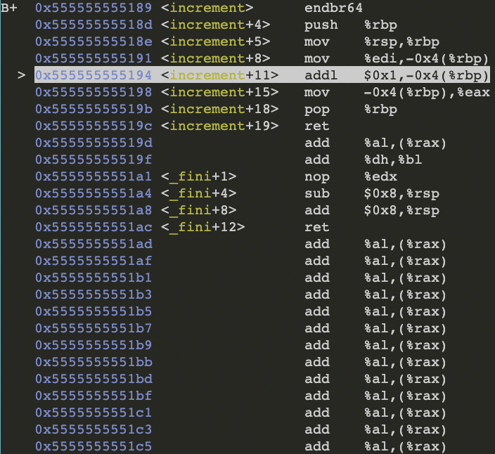
Tracing through the code w/ GDB
Now we stored the argument register value into our stack frame. To check that this update actually changed our stack frame, let’s print the integer that lies below the stack pointer:
x/-4bx $rbp → Read the previous 4 bytes
x/-1w $rbp → Read the previous word (word is the size of an integer)
We can see both of these led us to the value 5 being stored in the stack frame

Slide 49
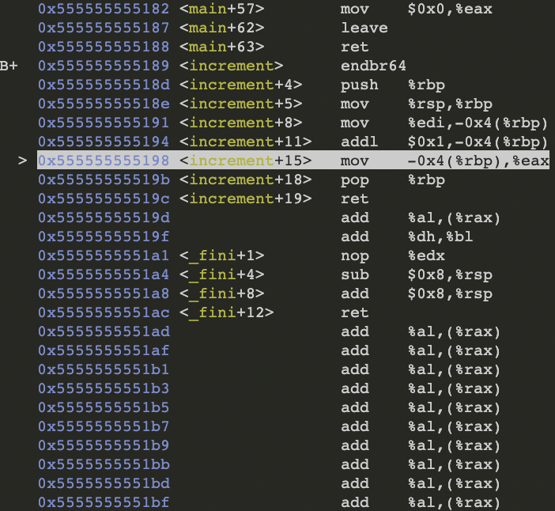
Tracing through the code w/ GDB
At this point, we’ve run the line to increment the value in the stack frame, and are waiting to execute this line.
To see if this change was made, let’s again print out the values:
x/-4bx $rbp → Read the previous 4 bytes as hex
x/-1wx $rbp → Read the previous word (word is the size of an integer) as hex
Since the value changed to 6, the increment was successful, and we can see where that change occurred.

Slide 50
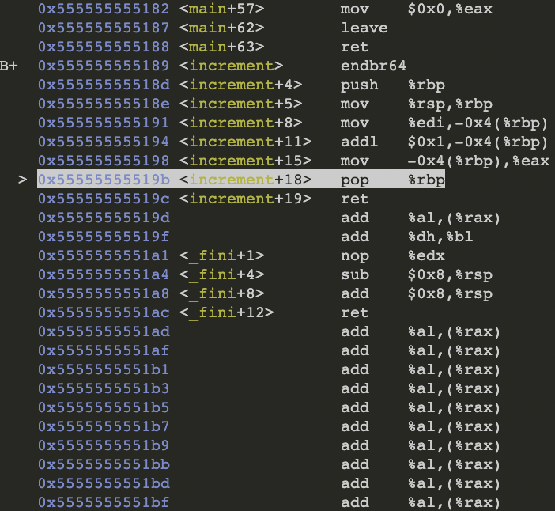
Tracing through the code w/ GDB
%eax, the return register, should contain the value 6 that we want to return to the user. Let’s see:
p $rax →
%eax now contains the accurate return value from our function, so we can return to the previous caller after adjusting the stack.

Slide 51
Lab 4
Assembly Lab: ASM!

Slide 52
Now, it’s your turn!
In lab 4, you will practice:
Reading assembly
Recognizing common patterns
Using gdb to debug assembly code + inspect memory!
Part A: Investigating the code!
Reading simple functions
Similar to what we just did
Deep dive into control flow, raise operations, hidden arguments
The Test.
Can you read assembly code tell me what it does?
Gradescope submission
Part B: Inspecting memory
Can you debug an executable by looking at assembly code and using gdb?
Gradescope submission

Slide 53
Malloc Tutorial
CS 0449: Introduction to System Software
Slides from Shinwoo Kim

Slide 54
Malloc Implementation
Consider an allocator implementation with the following characteristics:
The first-fit free algorithm is used to allocate data.
All blocks have a header with a size and a pointer to the previous block.
The header is 16B (2*8bytes) in size.
Positive sizes indicate the block is allocated, and negative sizes indicate it is free.
All freed blocks are immediately coalesced if possible.
When a block is split, the lower (first) part of the block becomes the allocated part and the upper (second) part becomes the new free block.
If the heap doesn’t have enough space to hold the data, it grows by the minimum amount needed to fit the data. Always successfully.

Slide 55
Malloc Implementation
Consider an allocator implementation with the following characteristics:
The first-fit free algorithm is used to allocate data.
All blocks have a header with a size and a pointer to the previous block.
The header is 16B (2*8bytes) in size.
Positive sizes indicate the block is allocated, and negative sizes indicate it is free.
All freed blocks are immediately coalesced if possible.
When a block is split, the lower (first) part of the block becomes the allocated part and the upper (second) part becomes the new free block.
If the heap doesn’t have enough space to hold the data, it grows by the minimum amount needed to fit the data. Always successfully.

Slide 56
Memory Diagram
E.g., the following heap contains an allocated block of size 16, followed by a free block of size 32. The top row contains memory addresses, and the bottom row contains the values stored at those memory addresses.
Address | 0xa000 | 0xa008 | … | 0xa020 | 0xa028 | …
Value | 16 | 0x0000 | … | -32 | 0xa000 | …
0xa000
0xa020
16
Allocated to user
-32
Free Block
What are these values?
🤷
16B
16B
16B
32B

Slide 57
Assuming an initially empty heap, and given the current state of the heap represented below, which of the malloc sequence was executed?
Address | 0xa000 | 0xa008 | …
Value | -64 | 0x0000 | …
The only block in the heap is a free block of size 64B
For there to be a free block, a block must first have been allocated, then freed
Look for malloc() and free() sequence (in that order!)
p0 = malloc(64); free(p0); | p0 = malloc(64); p1 = malloc(32); free(p0); free(p1);
p0 = malloc(64); | p0 = malloc(32); p1 = malloc(32); free(p0); free(p1);

Slide 58
Assuming an initially empty heap, and given the current state of the heap represented below, which of the malloc sequence was executed?
Address | 0xa000 | 0xa008 | …
Value | -64 | 0x0000 | …
p0 = malloc(64); free(p0); | p0 = malloc(64); p1 = malloc(32); free(p0); free(p1);
p0 = malloc(64); | p0 = malloc(32); p1 = malloc(32); free(p0); free(p1);
64
Allocated
32
Allocated
16B
64B
16B
32B

Slide 59
Assuming an initially empty heap, and given the current state of the heap represented below, which of the malloc sequence was executed?
Address | 0xa000 | 0xa008 | …
Value | -64 | 0x0000 | …
All freed blocks are immediately coalesced if possible.
p0 = malloc(64); free(p0); | p0 = malloc(64); p1 = malloc(32); free(p0); free(p1);
p0 = malloc(64); | p0 = malloc(32); p1 = malloc(32); free(p0); free(p1);
-64
Free
-32
Free
16B
64B
16B
32B

Slide 60
Assuming an initially empty heap, and given the current state of the heap represented below, which of the malloc sequence was executed?
Address | 0xa000 | 0xa008 | …
Value | -64 | 0x0000 | …
All freed blocks are immediately coalesced if possible.
p0 = malloc(64); free(p0); | p0 = malloc(64); p1 = malloc(32); free(p0); free(p1);
p0 = malloc(64); | p0 = malloc(32); p1 = malloc(32); free(p0); free(p1);
-64
Free
-32
Free
16B
64B
16B
32B

Slide 61
Assuming an initially empty heap, and given the current state of the heap represented below, which of the malloc sequence was executed?
Address | 0xa000 | 0xa008 | …
Value | -64 | 0x0000 | …
All freed blocks are immediately coalesced if possible.
p0 = malloc(64); free(p0); | p0 = malloc(64); p1 = malloc(32); free(p0); free(p1);
p0 = malloc(64); | p0 = malloc(32); p1 = malloc(32); free(p0); free(p1);
-64
Free
-112
16B
64B
16B
32B
112B

Slide 62
Assuming an initially empty heap, and given the current state of the heap represented below, which of the malloc sequence was executed?
Address | 0xa000 | 0xa008 | …
Value | -64 | 0x0000 | …
All freed blocks are immediately coalesced if possible.
p0 = malloc(64); free(p0); | p0 = malloc(64); p1 = malloc(32); free(p0); free(p1);
p0 = malloc(64); | p0 = malloc(32); p1 = malloc(32); free(p0); free(p1);
-32
Allocated
-32
Allocated
16B
32B
16B
32B

Slide 63
Assuming an initially empty heap, and given the current state of the heap represented below, which of the malloc sequence was executed?
Address | 0xa000 | 0xa008 | …
Value | -64 | 0x0000 | …
All freed blocks are immediately coalesced if possible.
p0 = malloc(64); free(p0); | p0 = malloc(64); p1 = malloc(32); free(p0); free(p1);
p0 = malloc(64); | p0 = malloc(32); p1 = malloc(32); free(p0); free(p1);
-32
Free
-32
Free
16B
32B
16B
32B

Slide 64
Assuming an initially empty heap, and given the current state of the heap represented below, which of the malloc sequence was executed?
Address | 0xa000 | 0xa008 | …
Value | -64 | 0x0000 | …
All freed blocks are immediately coalesced if possible.
When coalescing, the “header” of the second block is merged into the payload region
p0 = malloc(64); free(p0); | p0 = malloc(64); p1 = malloc(32); free(p0); free(p1);
p0 = malloc(64); | p0 = malloc(32); p1 = malloc(32); free(p0); free(p1);
-32
Free
-32
Free
16B
32B
16B
32B

Slide 65
Assuming an initially empty heap, and given the current state of the heap represented below, which of the malloc sequence was executed?
Address | 0xa000 | 0xa008 | …
Value | -64 | 0x0000 | …
All freed blocks are immediately coalesced if possible.
p0 = malloc(64); free(p0); | p0 = malloc(64); p1 = malloc(32); free(p0); free(p1);
p0 = malloc(64); | p0 = malloc(32); p1 = malloc(32); free(p0); free(p1);
-32
Free
-80
16B
32B
16B
32B
80B

Slide 66
Assuming an initially empty heap, and given the current state of the heap represented below, which of the malloc sequence was executed?
Address | 0xa000 | 0xa008 | …
Value | -64 | 0x0000 | …
The only block in the heap is a free block of size 64B
For there to be a free block, a block must first have been allocated, then freed
Look for malloc() and free() sequence (in that order!)
p0 = malloc(64); free(p0); | p0 = malloc(64); p1 = malloc(32); free(p0); free(p1);
p0 = malloc(64); | p0 = malloc(32); p1 = malloc(32); free(p0); free(p1);
-64
Free
16B
64B

Slide 67
Assuming the heap starts as drawn in the previous question, and given the final state of the heap represented below, which of the malloc sequence was executed?
Address | 0xa000 | 0xa008 | …
Value | -64 | 0x0000 | …
-64
Allocated
16B
64B
Address | 0xa000 | 0xa008 | … | 0xa020 | …
Value | 16 | 0x0000 | … | -32 | …
16
Allocated
-32
Free
Allocated block of size 16 ⇒ malloc(16) called
16B
16B
16B
32B
When splitting blocks, must use some space of payload to create new header
64B = 16B + 16B + 32B

Slide 68
Assuming the heap starts as drawn above (14 b.), if the following malloc executes, what is the value stored in p1?
Address | 0xa000 | 0xa008 | … | 0xa020 | …
Value | 16 | 0x0000 | … | -32 | …
p1 = malloc(32)
Allocate this block since it fits the size
16
Allocated
-32
Free
0xa000
16B
16B
0xa020
16B
32B
We should return this point to the user, not the start of the block.
If we return the start of the block (0xa020), the user might overwrite the header
(breaking our pointers to the next block) To calculate the memory address of this point:
0xa020 + sizeof(Header) = 0xa020 + 16B = 0xa030

Slide 69
Assuming the heap starts as drawn above (14 b.), which value can fill the blank to successfully free the first block?
Address | 0xa000 | 0xa008 | … | 0xa020 | …
Value | 16 | 0x0000 | … | -32 | …
free(???)
16
Allocated
-32
Free
0xa000
16B
16B
0xa020
16B
32B
To free this block using free(), the user needs to pass the pointer (memory address) of the payload region (which is returned by malloc() ).
→ Call free with 0xa000 + sizeof(Header)
= free(0xa010)
Why? The user does not know anything about blocks. They simply call free with the same pointer returned by malloc()

