Slide 1
Recitation 8: Fork/Dynamic Loading/Signals
CS 0449: Introduction to Systems Software
Griffin Hurt
Griffin Hurt
Undergraduate Teaching Fellow
griffhurt@pitt.edu
https://griffinhurt.com
Spring 2024, Term 2244
Friday 2 PM Recitation
Mar 22nd, 2024
Slides adapted from
Shinwoo Kim, Martha Dixon, and Vinicius Petrucci
Department of Computer Science
School of Computing & Information
University of Pittsburgh
Course News
Function Pointers
Quiz
Signals
Fork/Exec

Slide 2
Course News
Loading and Forking Lab is due Thursday, March 28th at 5:59 PM
Bomb Project is due Monday, March 25th at 5:59PM

Slide 3
Function Pointers
Don’t be scared!
We’ve covered pointers before
Only this time, we’ll be able to point to the memory address of a function…
We should be familiar with this idea from the assembly project… where we used a function’s address to change execution of a program
So… much like variables… functions have addresses too!
That we can point to!

Slide 4
How Can We Declare Function Pointers?
return_type (*pointer_name)(list,of,argument,types);
Let’s dissect this
First, we’ll start by declaring the functions return type
void, int, long, double char*, etc.
Next, the actual pointer variable to the function
*pointer_name is your choice of variable name, not the actual function name
Lastly, a list of argument types
So we know what kind of arguments we need to pass when dereferencing our function pointer
(int, int), (double, int), (int*, char*), etc.

Slide 5
How Can We Declare Function Pointers?
How can we call the functions we point to?
Well, in one of two ways
If we are explicitly declaring a function pointer to one of our written functions:
type (*ptr1)(int, int) = &fun1;
type (*ptr1)(int, int) = fun1;

Slide 6
Function Pointer Declarations - Option 1
type (*ptr1)(int, int) = &fun1;
Here, we’re declaring our function pointer which will point to an address of a function
Address means we need to dereference
Very similar to an int pointer
To access it, we need to use the dereference operator (*)
So, when actually calling the function, we can say:
(*ptr1)(num1, num2);

Slide 7
Function Pointer Declarations - Option 2
type (*ptr1)(int, int) = fun1;
Here, we’re declaring our function pointer which will point to an address of a function
However, since we’re not using the (&) operator, we don’t need to dereference first
Thus, our function pointer call is:
ptr1(num1, num2);
It looks identical to just calling fun1(num1, num2)

Slide 8
What’s the Difference?
Well… we might say the difference is in the address… but that turns out to not be quite the truth
Consider these two snippets
The pointer and it’s value are the same…

Slide 9
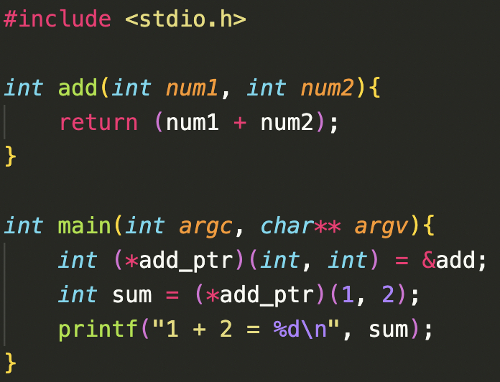
Option 1 - Example

Slide 10
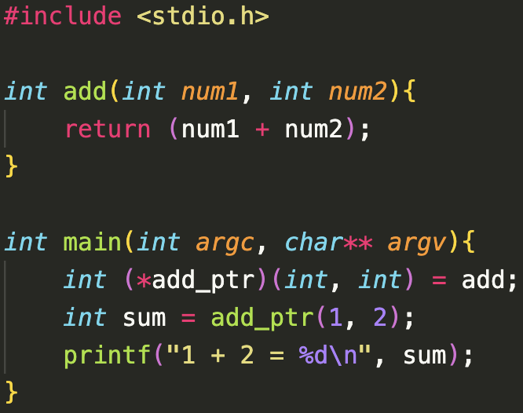
Option 2 - Example

Slide 11
Something Familiar
When talking about pointers, something else comes to mind…
Arrays are also pointers!
Can we create an array of functions?
Absolutely we can
This can actually prove to be quite useful

Slide 12
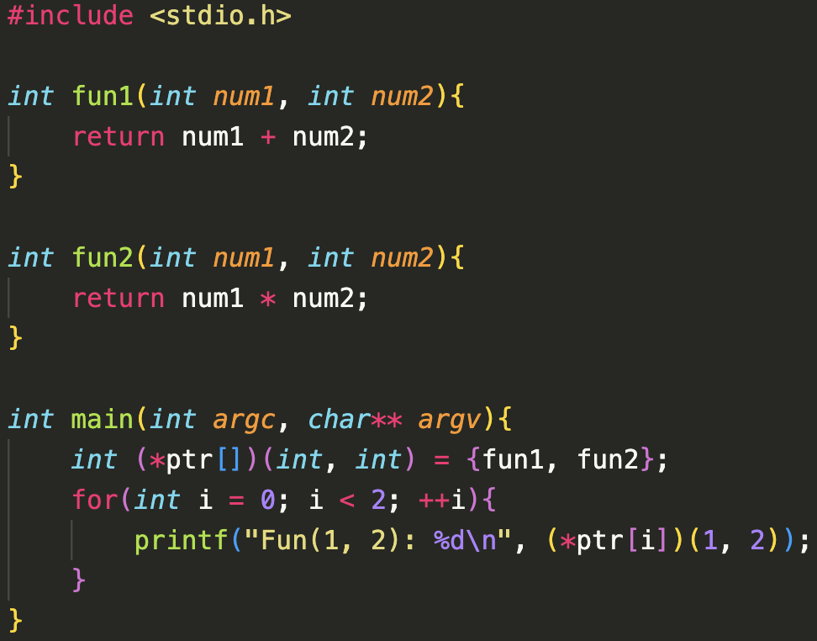
Example - Declared Array of Function Pointers

Slide 13
Example - Declared Array of Function Pointers
[] for array declaration
Array of functions
Dereference operator when trying to call function

Slide 14
Array of Function Pointers
What if I don’t know what functions I want in my array at compile time?
How can we add functions to the array?
Let’s try to declare an array of function pointers on the stack without initializing it

Slide 15
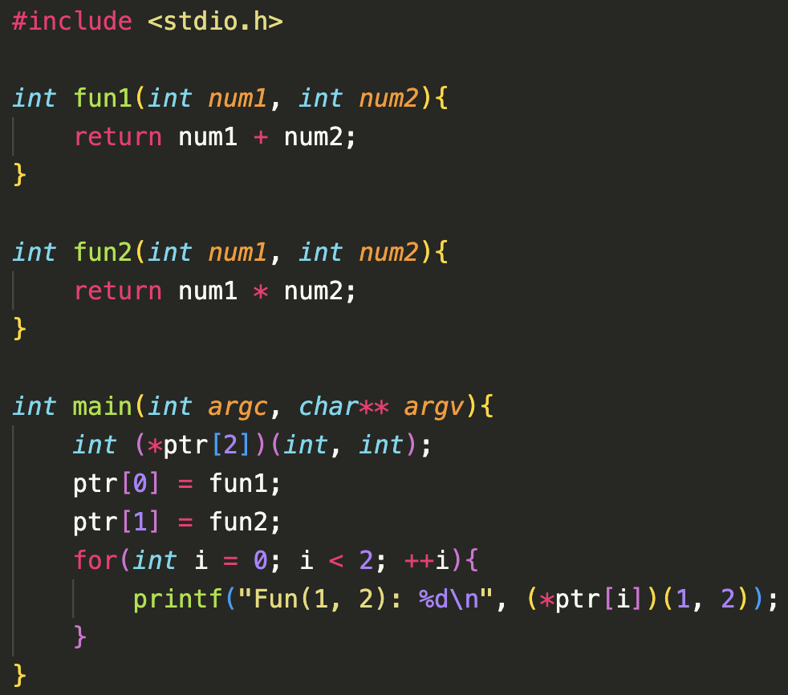
Example - Declared Array of Function Pointers

Slide 16
One Last Thing…
We can initialize an array, or create an empty array and fill it later
But what if I want to change the size of my array?
What about malloc?
Let’s create a function pointer that’s been dynamically allocated on the heap

Slide 17
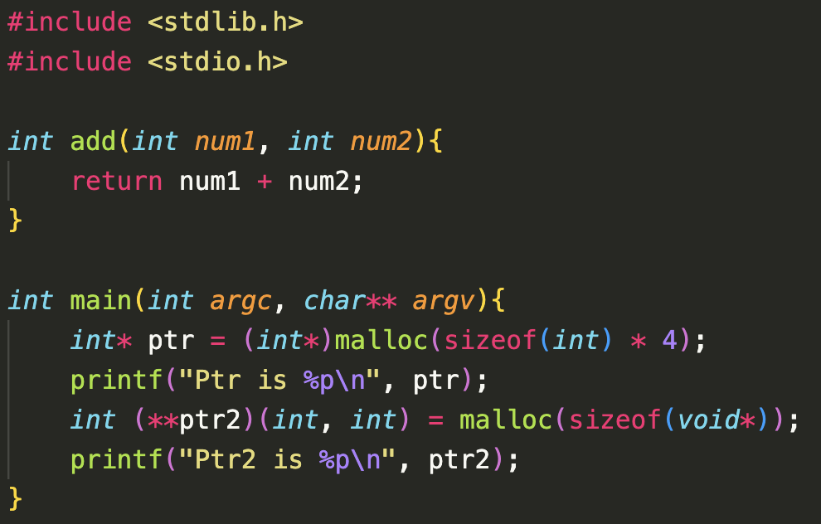
Example - Function Pointers and Malloc

Slide 18
One Last Last Thing…
Function pointers are of type void *
Still a pointer, so still 8 bytes
However, we don’t know its type
Hence, in the previous example, we’ll allocate using sizeof(void*) (8 bytes per function pointer)

Slide 19
qsort()
There’s a function pointer built in to C that will perform quicksort on a collection
Any collection
How can we do this?
The function that performs the calculation to determine if values need to be swapped must be passed in as a function pointer
This allows us to create our own collections and our own function, without changing the quicksort code
See Lab 5 description for more info on qsort()

Slide 20
Quiz time! Quiz is named Week ? Password is: ______

Slide 21
Part B - Fork, Exec, and Signal Handling

Slide 22
Part B - Signals
Processes can communicate to each other with signals
For example, something we should be familiar with by now is the interrupt signal, or Ctrl+C
The interrupt signal will communicate to your process that the program should be terminated

Slide 23
Part B - Signals
In C, we can actually catch these signals, and add some behavior to them
You might have seen this in Project 3, where the program didn’t end immediately after Ctrl+C was pressed, but instead printed out some information before exiting
How can we catch these signals?

Slide 24
Part B - Signals
In the <stdlib.h> library, there’s a function we can use called signal
signal(int interrupt, void* function_ptr)
Once signal detects the interrupt specified as a parameter (SIGKILL, SIGINT, etc), it will then execute the function pointed to by function_ptr, then perform the interrupt
Once we call signal, the process will always be on the lookout for that signal, and if it occurs, will run the function

Slide 25
Part B
For this part of the lab, we’ll need to use our knowledge of fork(), exec(), and signals
Our program needs to look for the interrupts SIGUSR1 and SIGUSR2
If SIGUSR1 is detected, fork a process have it run the command ls
If SIGUSR2 is detected, fork a process and have it run the command ls -l -a
Your program should also run in the exact specified order and print the specified information
IMPORTANT - when running processes with multiple threads, testing it once is not enough
Due to the unpredictability of the scheduler, running your program once time may be fine, but the next time text may print out of order
BE THOROUGH

Slide 26
Part A - Dynamic Libraries and Function Pointers

Slide 27
Part A
For this part of the lab, we need to use dlopen and dlsym from the <dlfcn.h> library
We’ll also need to create our plugin.c file and compile it to a shared object file (plugin.so)
To create the .so:
gcc plugin.c -o plugin.so -shared

Slide 28
Part A
Once we have a shared object file, we can load it into the main program using dlopen and call the functions using dlsym
void* dlopen(char* plugin_path, int mode)
Plugin path will be the so plugin we’re trying to run
For example, if I want to load the plugin called my_plugin.so, I’d use the path ./my_plugin.so
It returns a handle to be used by dlsym and dlclose()
Much like malloc, dlopen calls should be matched with a dlclose(handle) call

Slide 29
Part A
void* dlsym(void* handle, const char* fname)
Takes in a handle (returned by dlopen) and a function name to be called
Returns a function pointer to that function
For example, if I have a handle returned from dlopen and I want a function pointer to int fun1(int, long):
int (*fun_ptr)(int, long) = dlsym(handle, “fun1”);

Slide 30
Part A
From there, we can call the function same as any other function pointer
fun_ptr(my_int, my_long)
This will call the functions in the shared library

Slide 31
Part A - Assignment
You will need to write a plugin manager that takes a plugin name as a command line argument
The plugin should have 3 functions:
int initialize()
int run()
int cleanup()
Your plugin manager should be able to load and run all three of these functions
While also checking for errors

Slide 32
Fork()ing and Exec()uting

Slide 33
The fork() Call
int fork() will spawn a new process
The return value of fork will depend on the process
The parent will have its own (nonzero) process ID returned from fork
The child will have 0 returned
0 is NOT the child’s process ID, just a way to determine if the process is a child or parent
Both processes begin executing directly after the fork call
The child process will receive a copy of all current variables from the parent process

Slide 34
The wait() Call
The wait() call will wait for one child to finish
Wait will then return the process ID of the child that finished
If there are no children, wait() will return -1
If we want to wait on all children to finish, we can loop over wait() > 0
It will return -1 once there are no children left, then exit the loop
Wait only waits on children - it does NOT wait for grandchildren to finish executing

Slide 35
The exec() Calls
There are many different types of exec calls we can use
execv()
execve()
execvp()
execvpe()
Etc… see lecture slides for more examples on different exec functions
Let’s focus on execvp() for the time being

Slide 36
The execvp() Call
int execvp(const char* cmd, const char* args[])
Cmd is the command we want to execute
ls, cd, open, etc.
The args array is an array of strings to be executed (including the command we’re executing)
We can compile programs, run shell commands, open google chrome, etc.
Even open Minecraft!

Slide 37
The execvp() Call
In essence, the exec call will allow the process (whichever process it may be) to start running another executable
So how can we run commands?
Well, commands themselves have executables
Hence, in our example on the slides, we use the executable “/usr/bin/ls” when trying to run ls (at least, for execv)
For the sake of using execvp, we can pass in the commands we want to use directly
For example, to run the command cd my_dir:
execvp(“cd”, {“cd”, “my_dir”})

Slide 38
An Important Topic - Fork Tracing
Since we can fork from a parent, call fork again, and again, and again… our programs can become confusing
It’s also important to remember that our processes can be interrupted at any time, and execution for another process can begin
Thus, the order in which we fork() is NOT the order in which the processes will run
The order in which they run is determined by the Operating System Scheduler (which you’ll learn more about in future courses)

Slide 39
An Important Topic - Fork Tracing
When discussing fork tracing, we need to determine which possible orders the processes can run in
Since we can use instructions like wait(), we can limit these number of possible orders
However, we still need to trace which outputs are possible with a given program

Slide 40
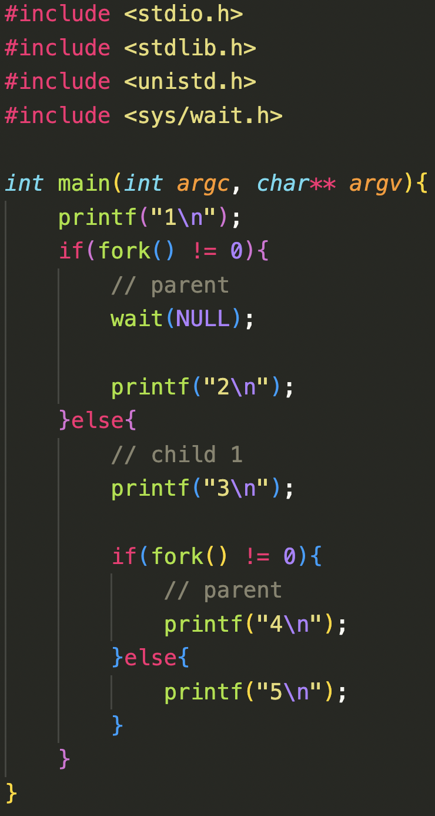
Fork Tracing Example

Slide 41
Can Certain Print Orders Happen?
Can we have an order of 2, 3, 4, 5, 1?

Slide 42
Can Certain Print Orders Happen?
Can we have an order of 2, 3, 4, 5, 1?
NO! But why?
At the beginning, there’s only one parent thread, so 1 must ALWAYS be printed first

Slide 43
Can Certain Print Orders Happen?
Can we have an order of 2, 3, 4, 5, 1?
NO! But why?
At the beginning, there’s only one parent thread, so 1 must ALWAYS be printed first
What about the order 1, 2, 3, 4, 5 happen?

Slide 44
Can Certain Print Orders Happen?
Can we have an order of 2, 3, 4, 5, 1?
NO! But why?
At the beginning, there’s only one parent thread, so 1 must ALWAYS be printed first
What about the order 1, 2, 3, 4, 5 happen?
NO! Because the first parent thread waits for the child to finish, so 2 can only be printed after the child finishes executing (after 3 and 4… but NOT 5)

Slide 45
Building a Fork Tree
P1
Print 1

Slide 46
Building a Fork Tree
P1
Print 1
P1
P2

Slide 47
Building a Fork Tree
P1
Print 1
P1
P2
Wait
Print 3

Slide 48
Building a Fork Tree
P1
Print 1
P1
P2
Wait
Print 3
P2
P3

Slide 49
Building a Fork Tree
P1
Print 1
P1
P2
Wait
Print 3
P2
P3
Print 4
Exit
Print 5
Exit

Slide 50
Building a Fork Tree
P1
Print 1
P1
P2
Wait
Print 3
Print 2
P2
P3
Print 4
Exit
Print 5
Exit

Slide 51
Building a Fork Tree
P1
Print 1
P1
P2
Wait
Print 3
Print 2
Exit
P2
P3
Print 4
Exit
Print 5
Exit

Slide 52
man strtok ^{abridged}
The strtok() function can help tokenize strings
#include <string.h>
char *strtok(char *str, const char *delim);
Breaks string str into a series of tokens using the delimiter delim.
Returns a pointer to the next token, or NULL if there are no more tokens.
Called in one of two ways:
strtok(str, d) // starts processing a new string
strtok(NULL, d) // continue processing a string

Slide 53
A strtok() example
#include <stdio.h>
#include <string.h>
int main(){
char str[] = "I:love-programming";
char delim[] = "-:";
char *token;
token = strtok(str, delim);
printf("%s\n", token);
return 0;
}
$ ./strtok_example
I
What will be printed?

Slide 54
A strtok() example
#include <stdio.h>
#include <string.h>
int main(){
char str[] = "I:love-programming";
char delim[] = "-:";
char *token;
token = strtok(str, delim);
printf("%s\n", token);
token = strtok(str, delim);
printf("%s\n", token);
return 0;
}
$ ./strtok_example
I
I
🤔 But the second token should be “love”
What will be printed?

Slide 55
A strtok() example
#include <stdio.h>
#include <string.h>
int main(){
char str[] = "I:love-programming";
char delim[] = "-:";
char *token;
token = strtok(str, delim);
printf("%s\n", token);
token = strtok(NULL, delim);
printf("%s\n", token);
return 0;
}
$ ./strtok_example
I
love
How can we print the remaining tokens?
What will be printed?

Slide 56
A strtok() example
char* s = “See the red fox”;
char* s =
S
e
e
t
h
e
r
e
d
f
o
x
\0
…
char* t = strtok(s, " ");
char* s =
S
e
e
\0
t
h
e
r
e
d
f
o
x
\0
…
t
char* t = strtok(NULL, " ");
char* s =
S
e
e
\0
t
h
e
\0
r
e
d
f
o
x
\0
…
t
char* t = strtok(NULL, " ");
char* s =
S
e
e
\0
t
h
e
\0
r
e
d
\0
f
o
x
\0
…
char* t = strtok(NULL, " ");
t
char* s =
S
e
e
\0
t
h
e
\0
r
e
d
\0
f
o
x
\0
…
char* t = strtok(NULL, " ");
t
t → NULL
strtok() changes the string that has been parsed!

