Slide 1
Recitation 11: Threads/Synchronization
CS 0449: Introduction to Systems Software
Griffin Hurt
Griffin Hurt
Undergraduate Teaching Fellow
griffhurt@pitt.edu
https://griffinhurt.com
Spring 2024, Term 2244
Friday 2 PM Recitation
Apr 12th, 2024
Slides adapted from
Shinwoo Kim, Martha Dixon, and Vinicius Petrucci
Department of Computer Science
School of Computing & Information
University of Pittsburgh
Course News
Threads
Synchronization
Quiz!
Conditional Variables

Slide 2
Course News
Threads Project due Friday, April 19th at 5:59PM
I’m going to refactor my website tonight so all slides will be posted
Sorry for the delay!

Slide 3
Threads
Achieving Concurrency without fork()s

Slide 4
Processes and Threads
Data
Files
Data
Files
Threads can share data!
Thread
Register
Stack
Register
Register
Register
Stack
Stack
Stack
Code
Code
Single-threaded process
Multi-threaded process
Notes:
Threads and processes are fundamental concepts in operating systems and concurrent programming. They represent units of execution that can run concurrently, allowing programs to perform multiple tasks simultaneously.
A process is an independent program in execution. It has its own memory space, resources, and state.
Processes are isolated from each other, meaning that the memory and resources of one process are typically not accessible by another process.
A thread is the smallest unit of execution within a process. Multiple threads within the same process share the same memory space and resources.
Threads in the same process can communicate easily through shared memory.
Multithreading is the concurrent execution of multiple threads within the same process.
Multithreading allows for parallelism and can improve the responsiveness of applications.

Slide 5
Posix Threads (pthread) — POSIX.1c
POSIX: Portable Operating System Interface
Standard to unify the program and system calls that many different operating systems provide
Provides us a ‘standard library’ to help create and manage threads
#include <pthread.h>
int pthread_create(pthread_t threadID,
FLAGS, void *(*function)(void *),
void *restrict arg);
int pthread_join(pthread_t thread, void **retval);
Other libraries exist
Win32 Threads for Windows
C11 Threads - not popular, not fully portable ^{Thanks Microsoft}
C++11 Threads - popular and widely used
Notes:
POSIX.1 is the base standard that defines the fundamental APIs for processes, files, and devices.
Additional standards, such as POSIX.2, POSIX.4, etc., extend the functionality to cover areas like shells, real-time features, threads, etc.
The pthread_join function is used to wait for a thread to complete its execution.

Slide 6
pthread_create()
#include <stdio.h>
#include <pthread.h>
void *do_stuff(void *p) //function to be executed by the thread
{
printf("Hello from thread %d\n", *(int *)p);
}
int main()
{
pthread_t thread; //variable to store thread ID
int id, arg1, arg2; //variables for thread IDs and arguments
arg1 = 1; //set the argument for the 1st thread
//create the 1st thread
id = pthread_create(&thread, NULL, do_stuff, (void *)&arg1);
arg2 = 2; //set the argument for the 2ed thread
do_stuff((void *)&arg2); //call the function directly for the 2ed thread
return 0;
}
Notes:
the second thread is not actually created using pthread_create, but instead, the do_stuff function is called directly with a different argument.
In the given code, there is a subtle issue. The pthread_create function may not have enough time to create the thread before the do_stuff function is called for the second time. This can lead to unexpected behavior.

Slide 7
Output
Hello from thread 2

Slide 8
pthread_create()
#include <stdio.h>
#include <pthread.h>
void *do_stuff(void *p)
{
printf("Hello from thread %d\n", *(int *)p);
}
int main()
{
pthread_t thread;
int id, arg1, arg2;
arg1 = 1;
id = pthread_create(&thread, NULL, do_stuff, (void *)&arg1);
arg2 = 2;
do_stuff((void *)&arg2);
return 0;
}
When the process exits, all threads are canceled. Here, the process exited before the second thread got to print its message

Slide 9
pthread_yield()
#include <stdio.h>
#include <pthread.h>
void *do_stuff(void *p)
{
printf("Hello from thread %d\n", *(int *)p);
}
int main()
{
pthread_t thread;
int id, arg1, arg2;
arg1 = 1;
id = pthread_create(&thread, NULL, do_stuff, (void *)&arg1);
pthread_yield();
arg2 = 2;
do_stuff((void *)&arg2);
return 0;
}
Notes:
The pthread_yield() function is used in multithreaded programs to voluntarily give up the processor so that other threads can execute. It's a way for a thread to explicitly indicate that it doesn't need the CPU right now, allowing other threads to have a chance to run.
Purpose: It provides a hint to the scheduler that the current thread is willing to give up its CPU time to allow other threads to run.

Slide 10
Output
Hello from thread 1
Hello from thread 2
pthread_yield() relinquishes the CPU
Allowing another thread to assume the CPU
Technically deprecated, but still portable and widely used!
⇒ You shouldn’t use it in your own code, but you may encounter it in the wild!

Slide 11
pthread_join()
#include <stdio.h>
#include <pthread.h>
void *do_stuff(void *p)
{
printf("Hello from thread %d\n", *(int *)p);
}
int main()
{
pthread_t thread;
int id, arg1, arg2;
arg1 = 1;
id = pthread_create(&thread, NULL, do_stuff, (void *)&arg1);
pthread_join(thread, NULL);
arg2 = 2;
do_stuff((void *)&arg2);
return 0;
}

Slide 12
Output
Hello from thread 1
Hello from thread 2
pthread_join(thread, NULL) waits until thread terminates

Slide 13
Linking the pthread library
At compile time, need to link the POSIX thread library to your code
Using -pthread option to gcc
gcc -o thread_program source.c -pthread
Writing a Makefile might be useful here…

Slide 14
Synchronization
The Dangers of Threading

Slide 15
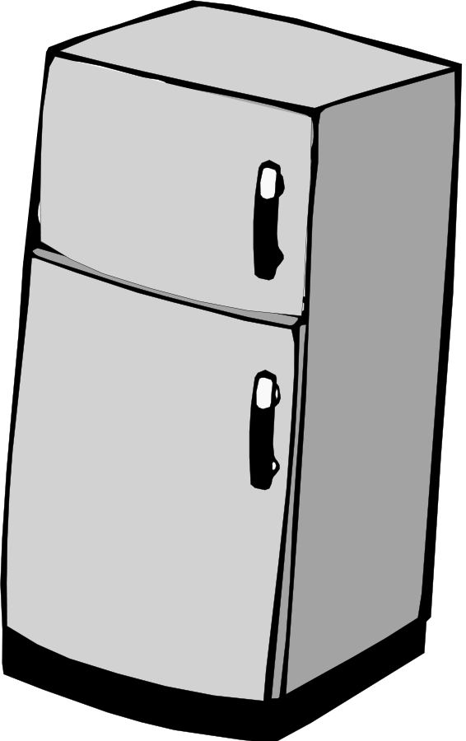
Race Condition: A Refrigerator Analogy
Alice and Bob are roommates living in a dorm
They share one refrigerator in the kitchen
Alice wakes up at 9:30 AM
She checks the refrigerator for milk and sees that there is none
She goes out to the store to get milk
While Alice is at the store, Bob wakes up
He checks the refrigerator for milk and sees that there is none
He goes out to the store to get milk
At 1 PM, Alice returns from the store
And places the milk in the fridge
At 1:30 PM, Bob returns from the store
And tries to place the milk in the fridge
But there’s already another milk in the fridge!
Notes:
A race condition is a phenomenon in computing where the behavior of a program depends on the relative timing of events, and the outcome becomes unpredictable when those events do not occur in a specific order. Race conditions typically happen in concurrent or multi-threaded programs, where multiple threads or processes access shared resources concurrently without proper synchronization.

Slide 16
Synchronization
What went wrong?
Bob and Alice did not communicate!
Some shared resource (refrigerator)
Time delay between checking the condition (looking inside the refrigerator)
And taking an action (placing milk inside refrigerator)

Slide 17
Race Conditions ^{Animated}
4
5
6
1
8
5
6
20
tail =
A[] =
9
?
enqueue()
A[tail] = 20;
tail++;
A[tail] = 9;
tail++;
thread switch
Thread A
Thread B

Slide 18
Synchronization
What went wrong?
The threads did not communicate!
Same problem may occur with processes!
Some shared resource (array)
Time delay between checking some condition (loading the tail)
And the action (updating the tail)
Preempted during this delay!
Scheduling can be random and preemption can happen at any time
Need some way to synchronize the threads
Need help from the operating system

Slide 19
Mutex
MUTual EXclusion
A mutex is a lock that only one thread can acquire
All other threads attempting to access the resource protected by a locked mutex will be blocked
#include <pthread.h>
int pthread_mutex_init(pthread_mutex_t, NULL)
Creates a new unlocked mutex
int pthread_mutex_lock(pthread_mutex_t*)
Waits until it can lock the mutex
int pthread_mutex_unlock(pthread_mutex_t*)
Unlocks the mutex
Notes:
Synchronization primitives are mechanisms provided by operating systems or programming languages to control access to shared resources, preventing race conditions and ensuring orderly execution of concurrent threads or processes. Some common synchronization primitives include:

Slide 20
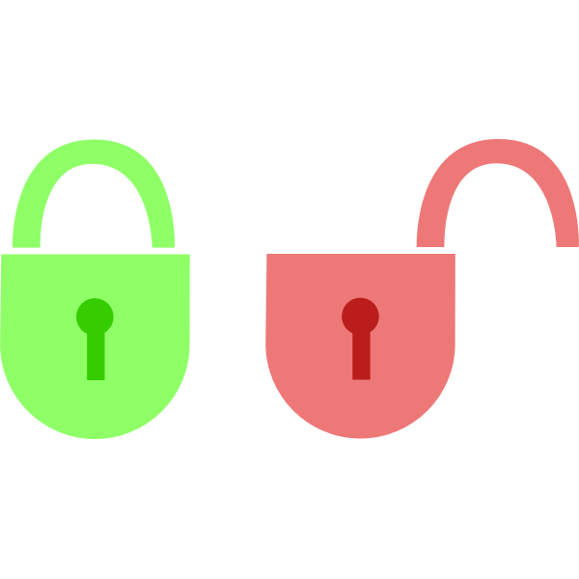
Fixing Race Conditions ^{Animated}
4
5
tail =
6
A[] =
1
8
5
6
20
9
mutex =
enqueue()
lock(&mutex);
A[tail] = 20;
tail++;
unlock(&mutex);
lock(&mutex);
A[tail] = 9;
tail++;
unlock(&mutex);
thread switch
Thread A
Thread B

Slide 21
Deadlocked
4
tail =
5
A[] =
1
8
5
6
20
mutex =
enqueue()
lock(&mutex);
A[tail] = 20;
tail++;
unlock(&mutex);
lock(&mutex);
A[tail] = 9;
tail++;
unlock(&mutex);
thread switch
Thread A
Thread B
Never Runs!

Slide 22
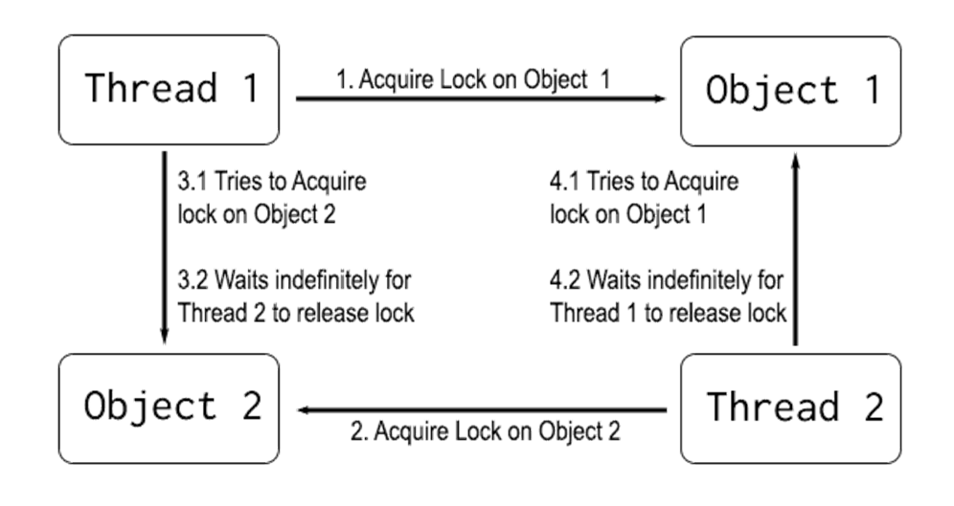
Be careful with synchronization primitives
“A set of processes are deadlocked if each process in the set is waiting for an event only another process in the set can cause”

Slide 23
Semaphores
A special counter used for synchronization
Essentially counties the number of free resources
Down (wait) reduces the counter
Denoting that a resource is being used
Waits if the counter is 0
Up (signal) operation increases the counter
Denoting that a resource is now free
#include <semaphore.h>
int sem_init(sem_t*, 0, unsigned int initial_value);
Creates a semaphore with the given initial value. (The second argument means it the semaphore data is in shared memory. If non-zero, it can’t be seen by other threads.)
int sem_wait(sem_t*);
Decrements counter unless it is 0 in which case it waits.
int sem_post(sem_t*);
Increments counter.

Slide 24
Quiz time!
Password is ________

Slide 25
Condition Variables
A condition under which a thread executes or is blocked

Slide 26
Condition Variables
Condition Variables are used to wait for a particular condition to become true
wait(condition, lock): release lock, put thread to sleep until condition is signaled; when thread wakes up again, re-acquire lock before returning.
signal(condition, lock): if any threads are waiting on condition, wake up one of them. Caller must hold lock, which must be the same as the lock used in the wait call.
broadcast(condition, lock): same as signal, except wake up all waiting threads.
Notes:
Condition variables are used to signal between threads when a certain condition is met.

Slide 27
Condition Variables
Essentially a queue of waiting threads
Thread B waits for a signal on CV before running
wait(CV, …);
Thread A sends signal() on CV when time for B to run
signal(CV, …);

Slide 28
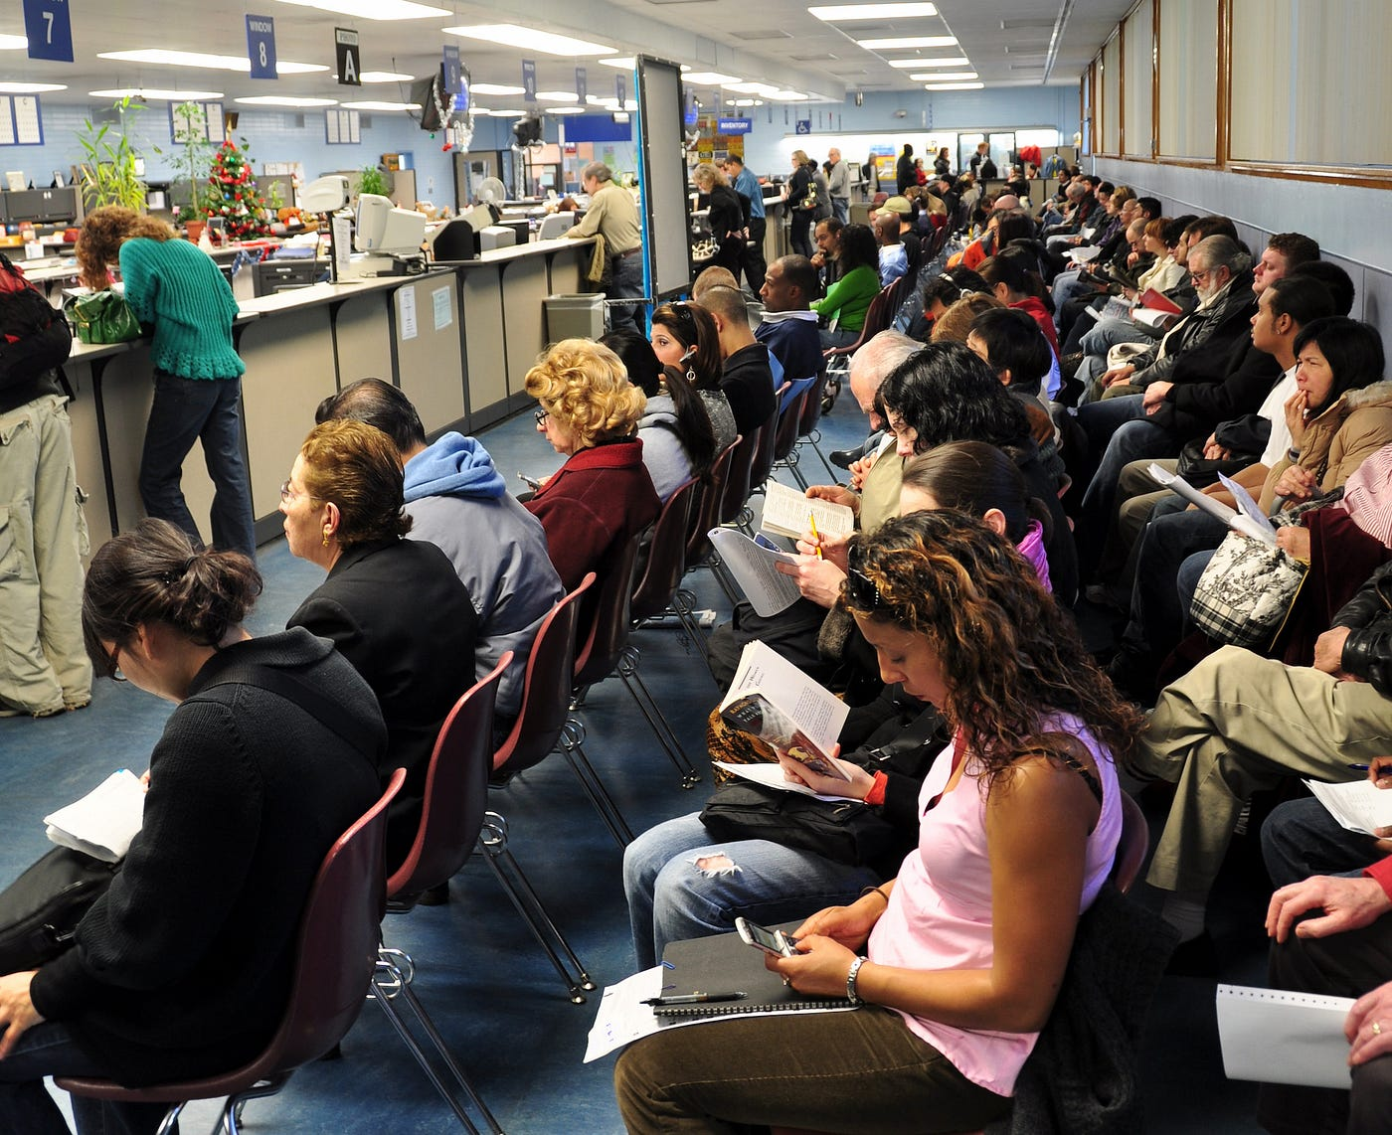
Condition Variables at the DMV
Consider PennDOT (DMV)
Which serves two functions:
Title work
License renewal
Critical resource: representative; threads: people in line
When a title-works window representative comes to the window after a break, a condition ‘title_window_ready’ is satisfied.
The title representative could look for the next ticket (for title work) and signal the customer to come to the window.
Here we have two condition variables, title_window_ready & license_window_ready.
These conditions satisfy if one customer is handled and now the representative is ready to handle next customer.

Slide 29
The Bridge Problem
Consider a narrow bridge that can only allow three vehicles in the same direction to cross at the same time.
If there are three vehicles on the bridge, any incoming vehicle must wait as shown below.

Slide 30
The Bridge Problem
When new cars get to the bridge, have them wait
if(new car from left) wait(left, bridgelock)

Slide 31
The Bridge Problem
When a vehicle exits the bridge, we have two cases to consider.
Case 1: there are other vehicles on the bridge
Shown below
In this case, one vehicle in the same direction should be allowed to proceed
Case 2: the exiting vehicle is the last one on bridge.
if(bridge.numCars != 0) signal(left, bridgelock)

Slide 32
The Bridge Problem
Case 2 is more complicated and has two subcases.
In this case, the exiting vehicle is the last vehicle on the bridge.
If there are vehicles waiting in the opposite direction, one of them should be allowed to proceed. This is illustrated below:
if(bridge.numCars == 0 && rightCars != 0) signal(right, bridgelock)

Slide 33
The Bridge Problem
Or, if there is no vehicle waiting in the opposite direction, then let the waiting vehicle in the same direction to proceed.
if(bridge.numCars == 0 && rightCars == 0) signal(left, bridgelock)

Slide 34
Problem with the Bridge Problem
Consider Case 1: there are other vehicles on the bridge
Shown below
In this case, one vehicle in the same direction should be allowed to proceed
But what if there are infinite number of vehicles on the left?
Will the vehicles on the right ever get to go?
if(bridge.numCars != 0) signal(left, bridgelock)

Slide 35
Starvation
Starvation describes a situation where a thread is unable to gain regular access to shared resources and is unable to make progress.
This happens when shared resources are made unavailable for long periods by "greedy" threads.

Slide 36
Live Lock
A Livelock is when two tasks are actively signaling the other to go and making no progress.
Example: Two friends at a dinner table with only one spoon
A tells B to use the spoon and eat first
B tells A to use the spoon and eat first
A tells B to use the spoon and eat first
…
No one gets to eat
Aside: This is a weird example…
Why are you at a dinner table with only one spoon?
Why doesn’t one of them go and get another spoon?
Many ‘classical IPC problems’ are built around weird premises ¹⁵⁵⁰
Dining Philosopher Problems
Sleeping Barber Problem
Notes:
Livelock: → one type of starvation
Livelock is a situation where processes or threads continuously change their states in response to the actions of others but make no actual progress.

